Slide 1
Calibration of building energy models from BMS bulk logging and analytics software

Slide 2


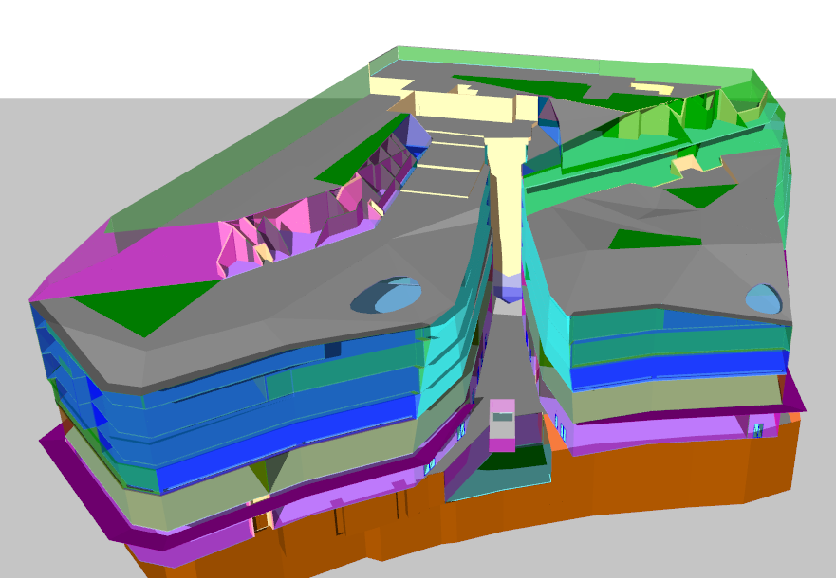
Project Building -- One New Change
Aerial view of One New Change
Tas building model

Slide 3
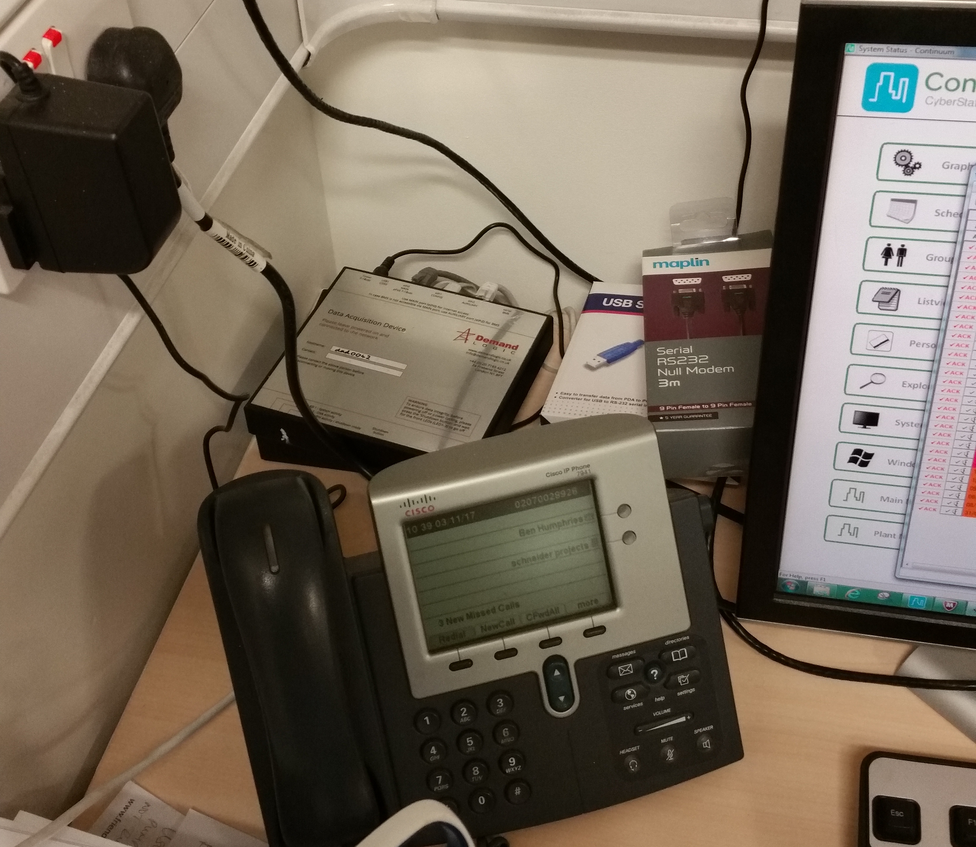

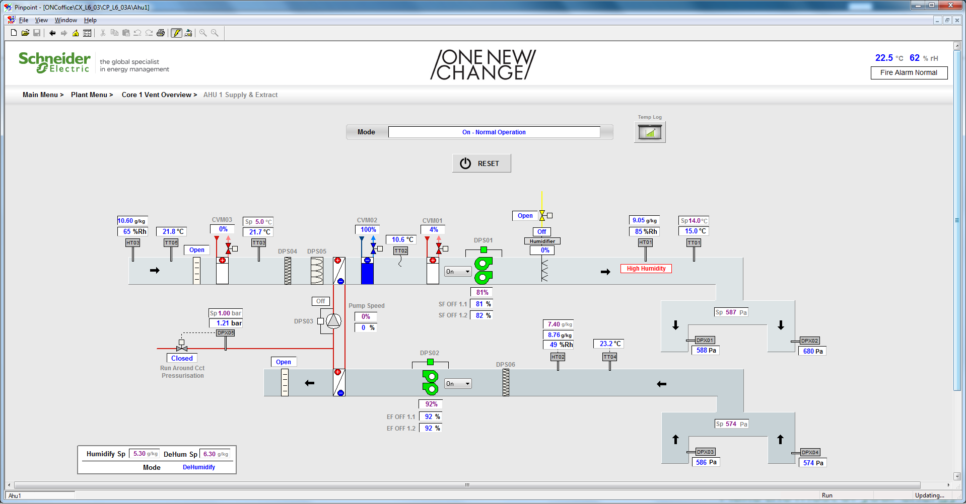
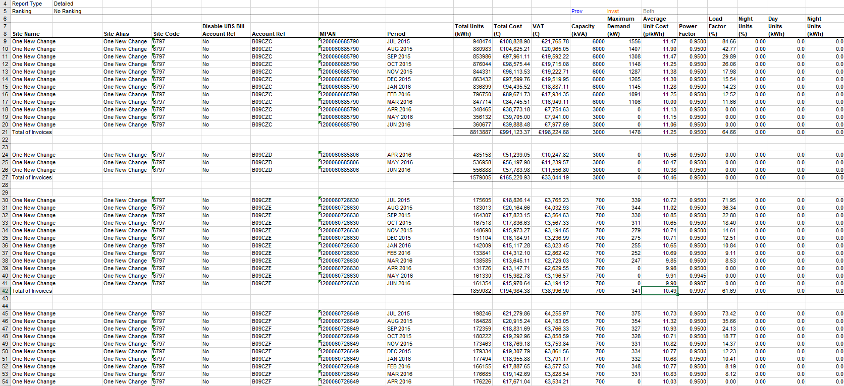
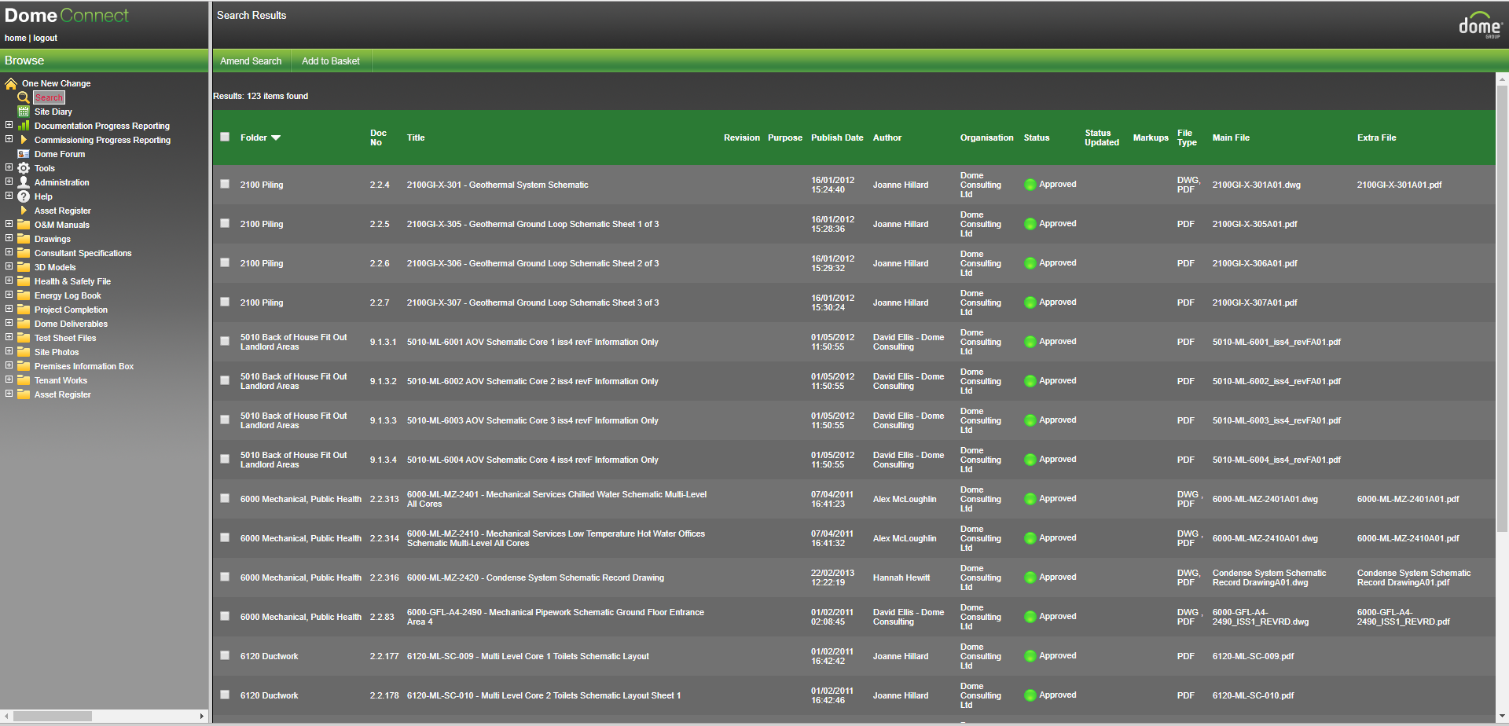
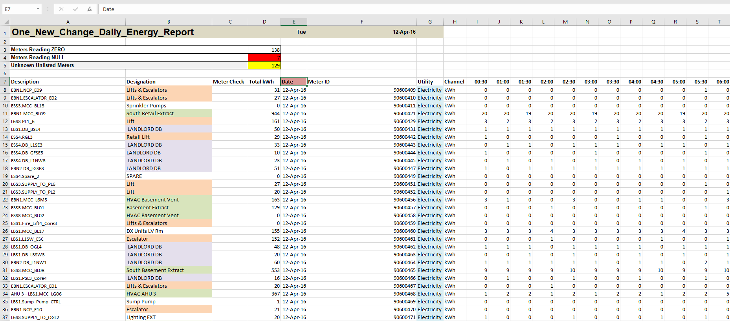
Data inputs to the calibrated model
DL Logged BMS data
Weather station on ONC
Calibrated Model
BMS screen grabs
Utility bills
O&M data
Metering data

Slide 4
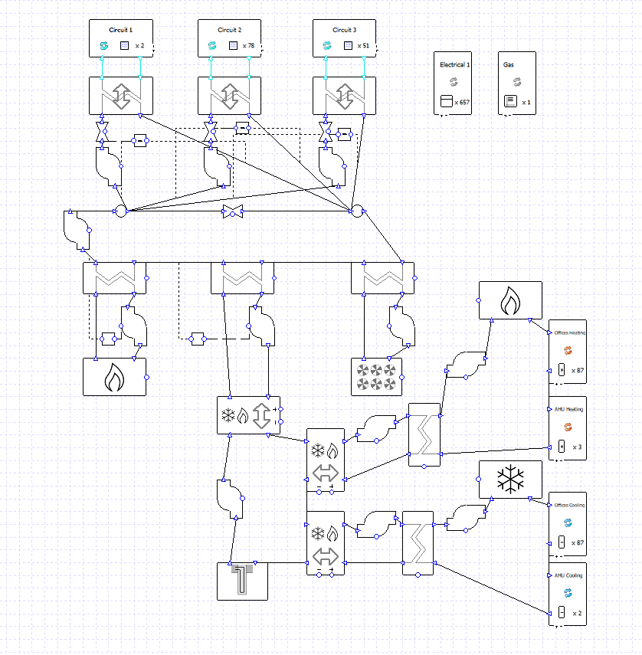
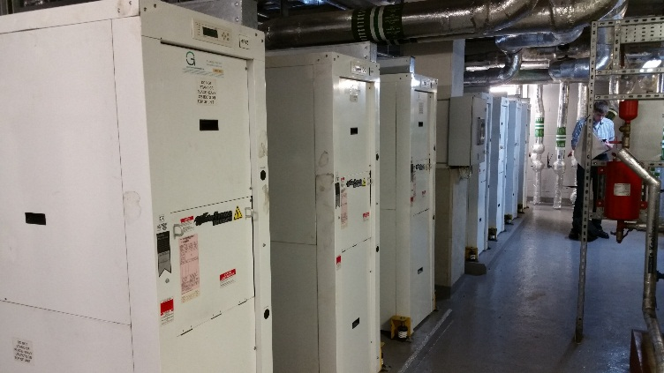
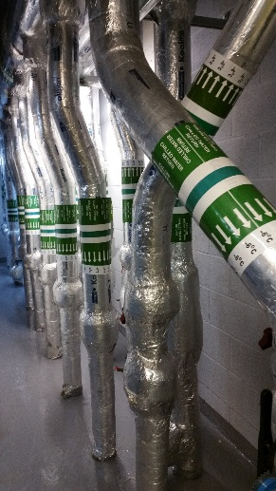
Waterside plant model
Retail unit’s HPs
Retail condenser loop
DAC
Office boilers
GSHPs
Office FCUs and AHU heating
Condenser loop
boilers
Ground loops
Office chillers
Office FCUs and AHU cooling

Slide 5
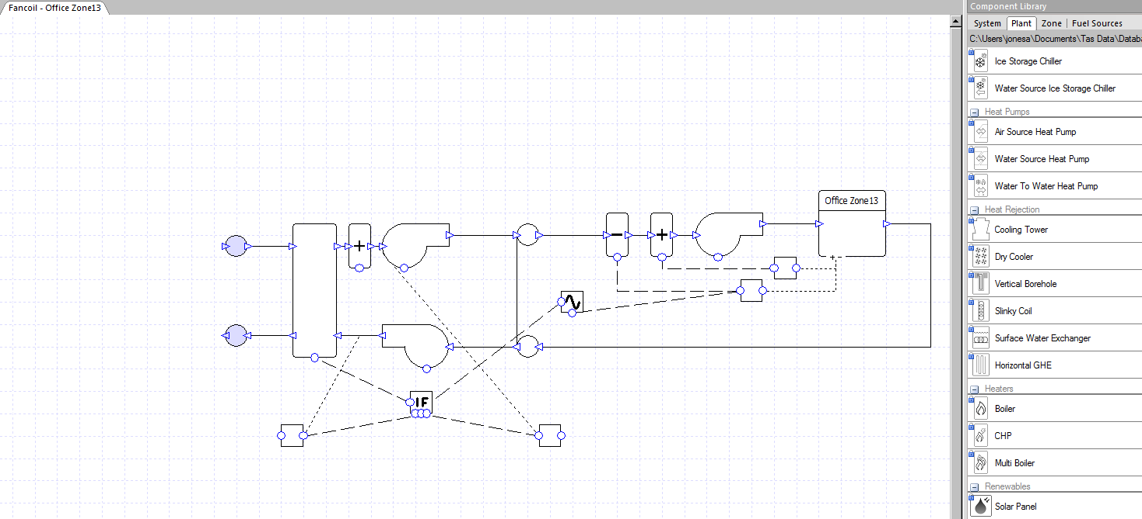
Office airside AHU and FCU model

Slide 6
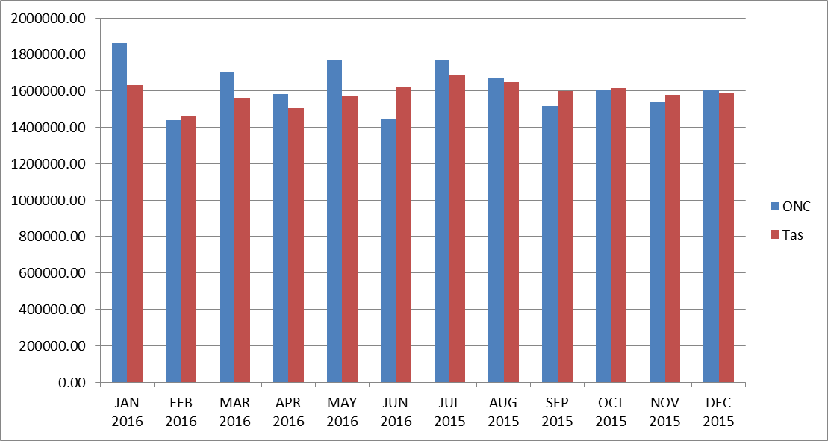
Performance overview following calibration
Gas and electricity billing information for the whole site was supplied by Land Securities for the period July 2015 to June 2016. There were two billing anomalies, no gas information for June and January’s gas consumption was extremely abnormally elevated.
Including the two anomalies gives a peak monthly error of 12.2% in January 2016 and an average error across the whole year of 5.5%
Monthly energy consumption kWh
The total simulated annual energy cost for the period is £1,602,217.00 for grid supplied electricity and £175,866.50 for Natural gas. The total is £1,778,083.50, which is within 2.5% of the billed energy. The difference being mainly on gas.
The £1,778,083.50 simulated annual cost will be used to calculate savings on some energy conservation measures.

Slide 7
Whilst the overall simulated performance matches well with the actual performance, good agreement was also found in the detailed performance of individual components and process.
A few of these will be highlighted below.

Slide 8
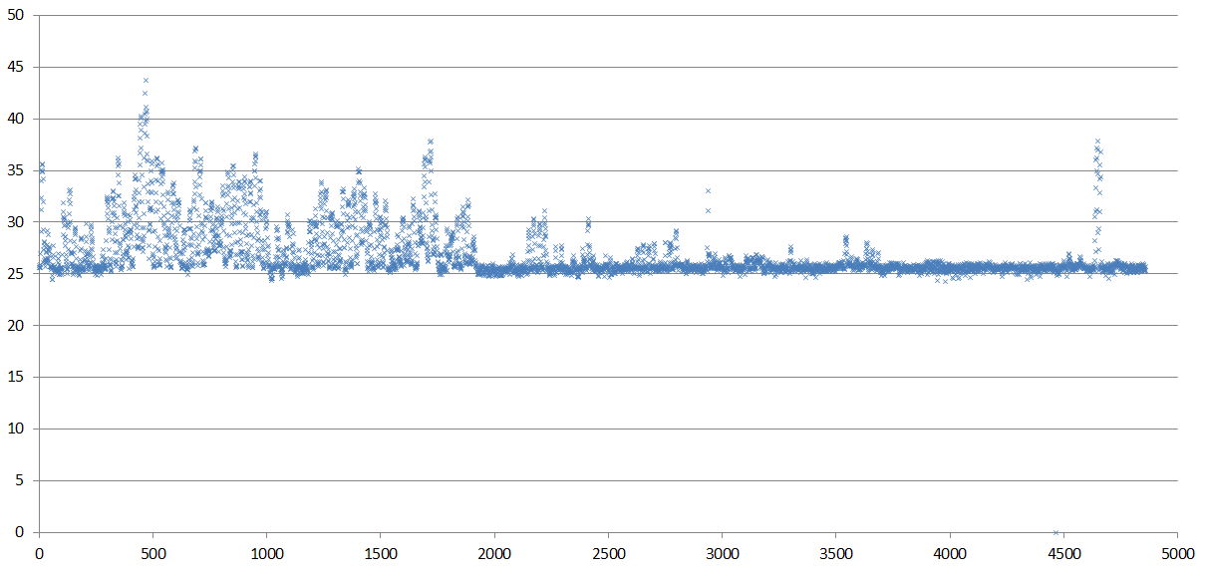
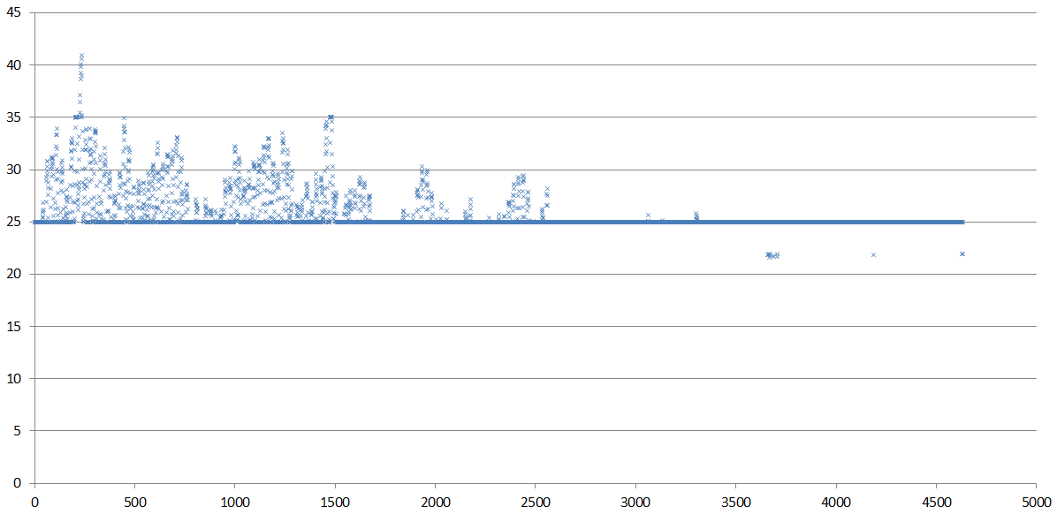
Retail condenser loop temperature
Last 6 months of 2015
Due to high heat rejection from the retail units in the summer months the condenser loop temperature reaches a peak of ~44C. The simulated peak is ~42C at the same time of year.
The shape of the variation in condenser loop temperature is identical for monitored and simulated data. This is because the building and systems is being driven by the same weather data as is the Tas model.
The weather station, mounted of the roof of ONC for this project, was a key element in the validation of Tas calculation procedures.
Heat is extracted from the condenser loop by the DAC.
Monitored D L data
Retail condenser loop temp C
Simulated data
Retail condenser loop temp C

Slide 9
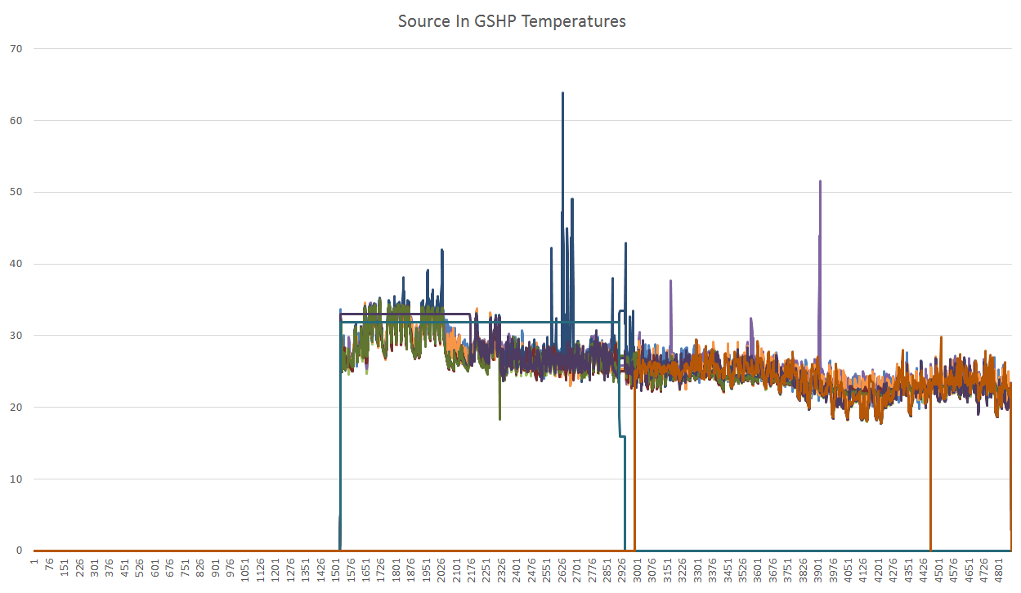
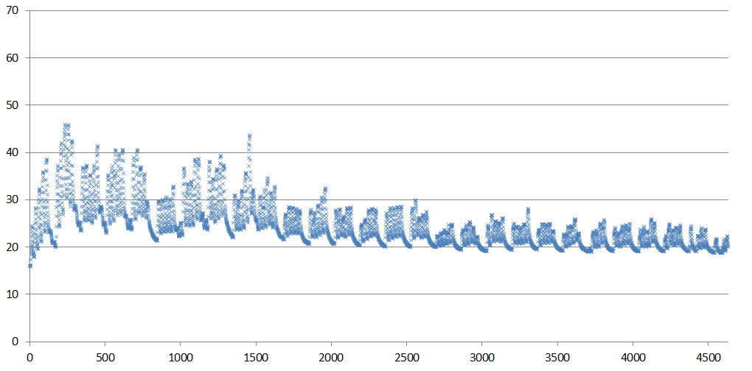
Ground loop temperature
Spikes and drop-out
may be ignored
The ground loop at ONC uses 13 GSHPs to supply heating and cooling to the retail and office systems. The graphs below show the monitored flow temperature from the ground loop to the GSHPs from mid August to the end of 2015. The simulated temperature is shown below for the last 6 months of 2015.

Slide 10
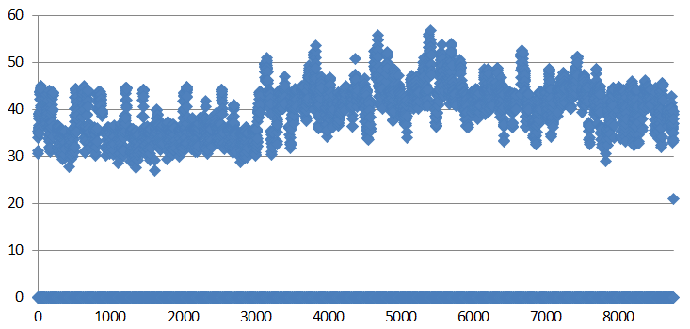
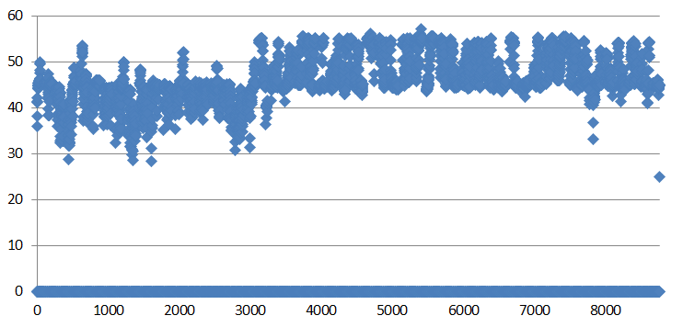
Office humidity control
The as commissioned office humidity control was based on supply air absolute humidity being controlled to between 5.3g/kg and 6.3g/kg. this resulted in the office humidity being below 40% for long periods through the year and even below 30% for a significant time.
Simulations suggested that control of return air absolute humidity between 7.3g/kg and 8.9g/kg would make a significant improvement in office humidity levels.
This strategy has been implemented and office space conditions have improved as predicted.
Besides the improvement in occupant well being, the change in control strategy is predicted to save £61,550 per year.
Office humidity during occupied hours with supply air control
Office humidity during occupied hours with return air control

Slide 11
Further office comfort improvement and energy savings
There are two main issues with the office FCU operation which affect comfort and energy consumption; ‘hunting’, due to too small a FCU deadband setting, and secondly, local difference in thermostat control settings (as set by occupants). These issues are modelled by an overlapping control band on heating and cooling for the FCU. The NG Bailey strategy is to re-set the thermostat setting and increase the deadband by 0.5C to 1C.
When these were implemented in the Tas model the results showed an energy saving of £150,000 and a significant improvement in occupant comfort.
This aspect of the project has been important in prompting the development of more advanced FCU modelling to take account of the effects of poor deadband control and setpoint variations.

Slide 12
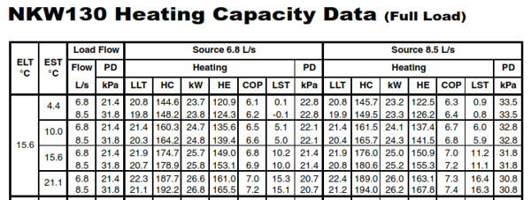
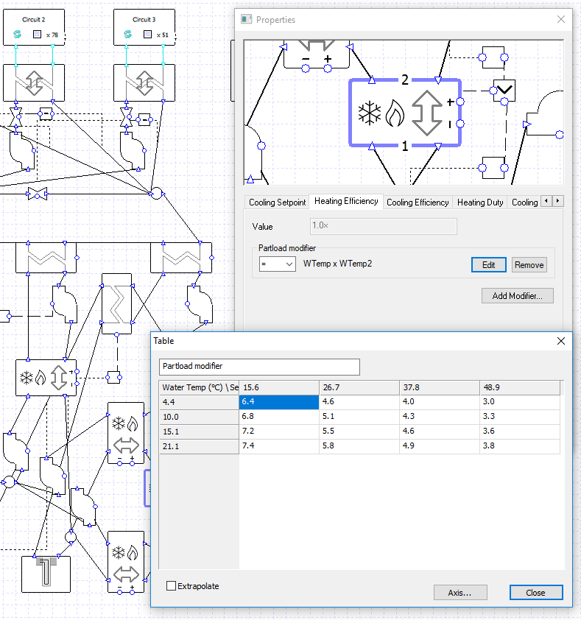
Ground loop optimisation
Because of the variation in heat pump performance (shown to the right). Selecting an optimum control strategy for controlling ground loop temperature is non-trivial.
A parametric study, varying setpoint and size of control band, gives an indication of the best approach.
Starting with a base case of 16C setpoint and a band of 27C, the following table shows the percentage energy reduction (or increase) for each alternative.
 | Setpoint
Band | 16 | 13 | 19 | 10 | 22
27 | 0.00%
10 | -0.85% | 3.14% | 0.87%
0 | 47.1% | 49.82% | 42.82% | 41.55% | 45.63%

