Slide 1
Calibrated Energy Models: One New Change
London, UK

Slide 2

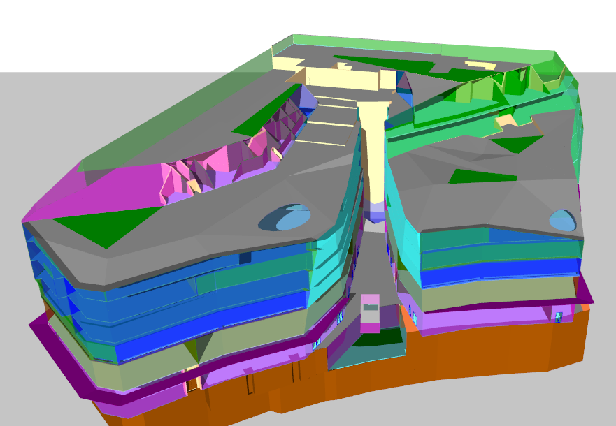
For most buildings, there is a performance gap between actual and predicted usage:
Actual usage
(kWh/ year)
>>
Simulated usage
(kWh/ year)

Slide 3
Real buildings are subject to natural variations in weather, occupant behavior, and other factors
≠
Measured data
Predicted input data

Slide 4
Can we employ post-occupancy performance modelling to close the performance gap?
Actual usage
(kWh/ year)
=
Simulated usage
(kWh/ year)

Slide 5
Case Study: One New Change project
This project set out to assess potential benefits of post-occupancy performance modelling. This strategic activity encompasses building energy modelling, post-occupancy monitoring, model calibration, energy conservation measure (ECM) assessment, and a continuous cycle of adjustment and improvement.
EDSL worked alongside industry partners on this project funded by Innovate UK, a government-backed initiative to foster productivity and economic growth through business-led research, development, and implementation.
The project consisted of analysing a mixed-use retail/ office building located near St Paul’s Cathedral in London. The team sought to identify opportunities to optimize energy efficiency without sacrificing occupant comfort or building services.

Slide 6

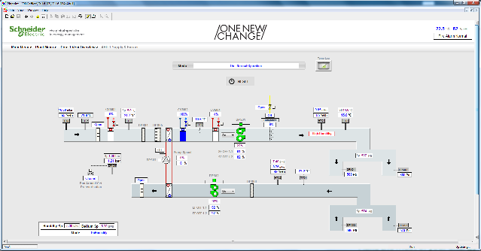
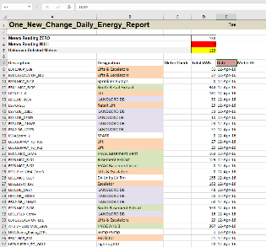


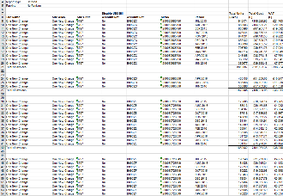

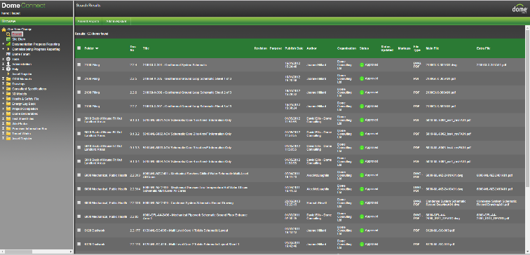


Building Operations
Data was collected from the facility while in operation. A weather station was installed on the building’s roof to capture conditions as accurately as possible. Utility bills, metering data, O&M data and BMS system data provided a complete picture of the overall loads, usage patterns, and performance drivers.
BMS screen grabs
Utility bills
Metering data
Onsite weather station
O&M data

Slide 7
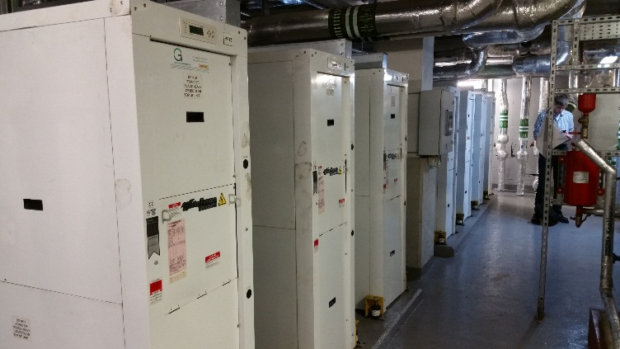
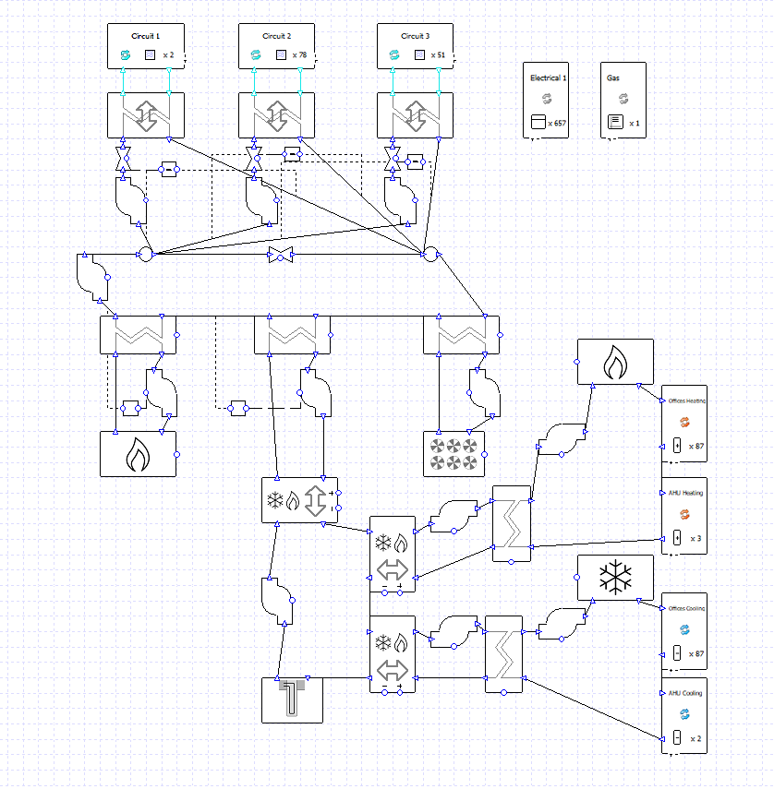
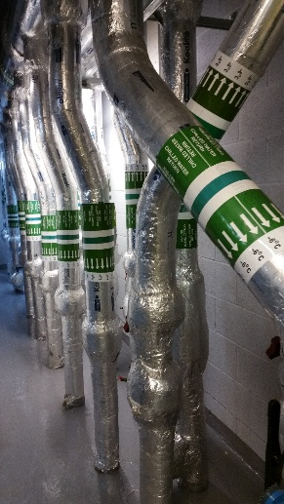
Plant Room Model
Retail unit’s HPs
Retail condenser loop
GSHPs
Office boilers
Condenser loop boilers
DAC
Office FCUs and AHU heating
Office chillers
Office FCUs and AHU cooling
Ground loops

Slide 8
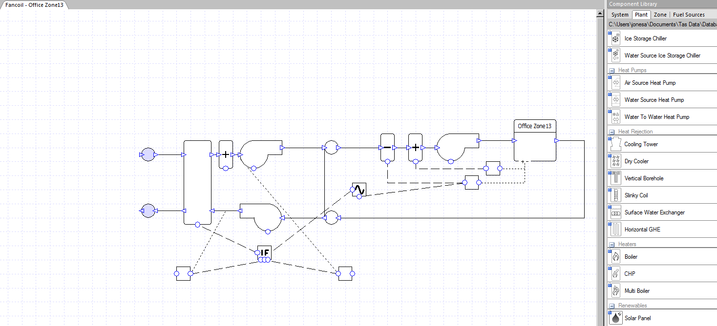
Office Airside Model
Typical AHU and FCU system diagram

Slide 9
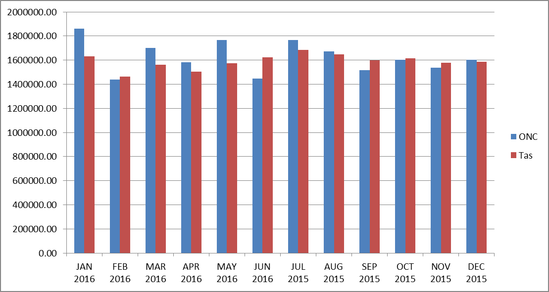
Overall Simulated Performance
Billing data vs simulation
Gas and electricity billing information was supplied for the July 2015 - June 2016 time period. There were two billing anomalies in the data: No gas information for June, and January’s consumption included data from a prior month.
Including the two anomalies, peak monthly error = 12.2% (Jan 2016), and average annual error = 5.5%
Total simulated annual energy cost: £1,778,084
£ 1,602,217 grid-supplied electricity
£ 175,866 natural gas
Total simulated cost is within 2.5% of billed cost, with the difference being mainly on gas. This cost will be used to calculate savings on energy conservation measures.
Monthly Energy Consumption (MWh)
Tas simulation
actual

Slide 10
Detailed Simulated Performance
Whilst the overall simulated performance matches well with the actual performance, good agreement was also found in the detailed performance of individual components and process.
A few of these will be highlighted:
Retail condenser loop temperature
Ground loop temperature
Office humidity control

Slide 11
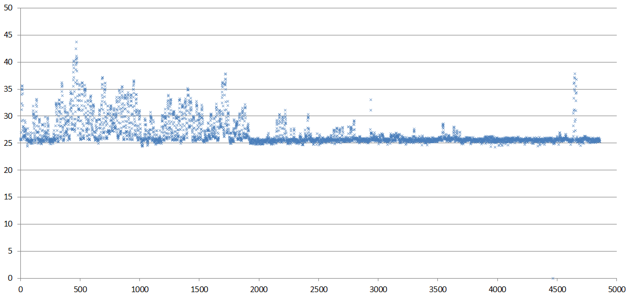
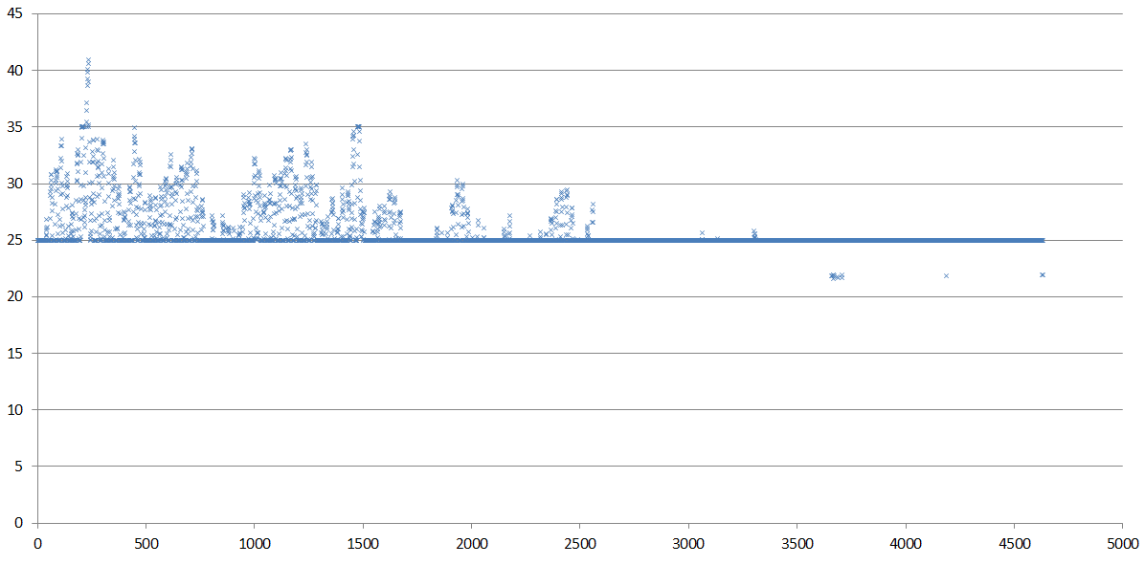
Detailed Simulated Performance
Measured
Simulated
Retail condenser loop temperature (C°)
Due to high heat rejection from the retail units in the summer months the condenser loop temperature reaches a peak of ~44°C. The simulated peak is ~42°C at the same time of year.
The shape of the variation in condenser loop temperature is identical for monitored and simulated data. This is because the observed weather data is being recorded on-premises and is used within the Tas model.
Heat is extracted from the condenser loop by the dry air cooler (DAC).
Monitored Data
Simulated in Tas

Slide 12
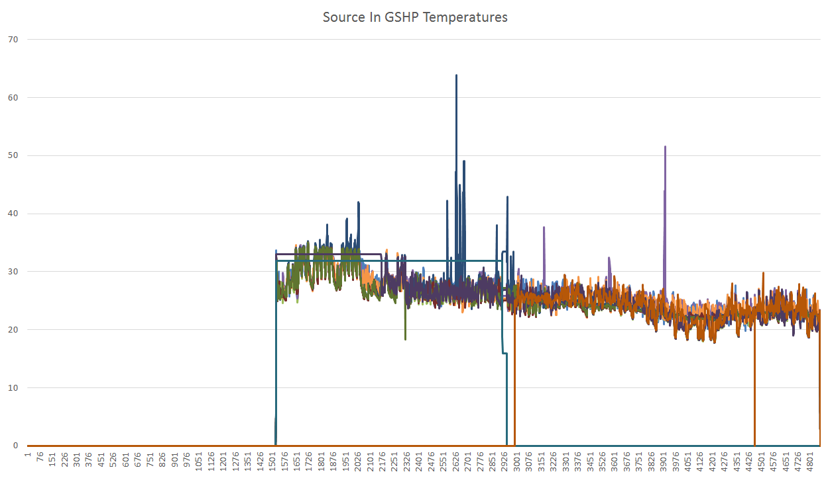
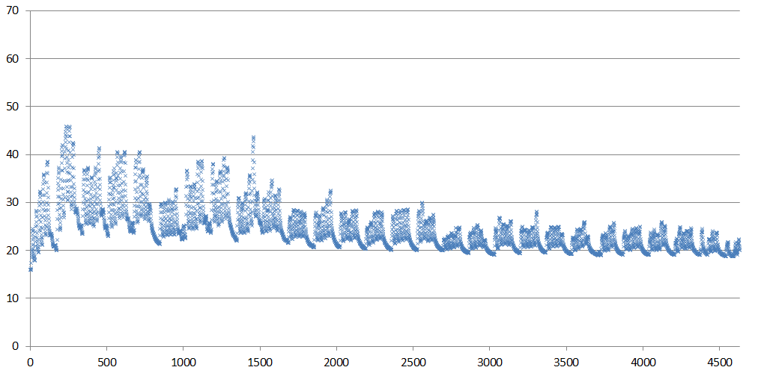
Detailed Simulated Performance
Ground loop temperature
Spikes and drop-outs
may be ignored
One New Change’s ground loop uses 13 ground-source heat pumps (GSHPs) to supply heating and cooling to the retail and office systems.
These graphs show monitored flow temperature from
Total simulated annual energy cost: £1,778,084
£1,602,217: grid-supplied electricity
£175,866.50: natural gas
Total simulated cost is within 2.5% of billed cost, with the difference being mainly on gas. This cost will be used to calculate savings on energy conservation measures.
the ground loop to the GSHPs from mid- August to the end of 2015.
The simulated temperature is shown for the last 6 months of 2015.
Monitored Flow Temp
Simulated Flow Temperature

Slide 13
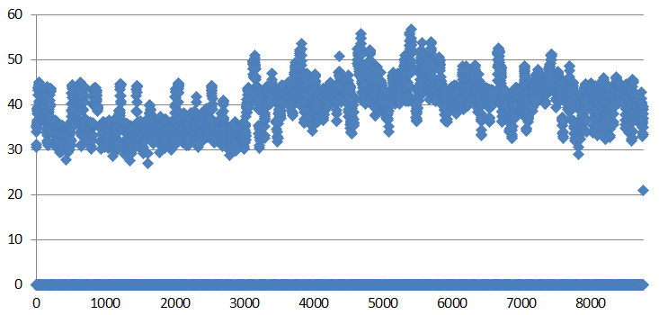
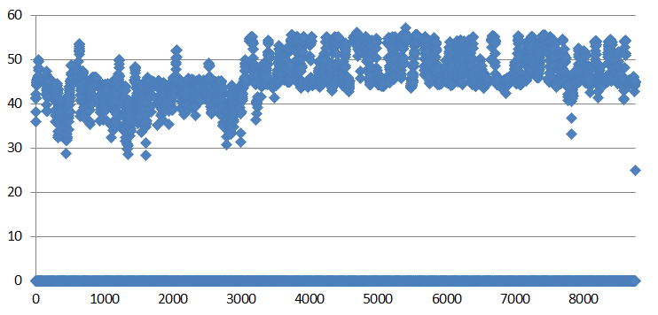
Detailed Simulated Performance
Office humidity control
The as-commissioned office humidity control was based on supply air absolute humidity being maintained within a range of 5.3g/kg and 6.3g/kg. It resulted in office humidity being below 40% for long periods through the year and even below 30% for a significant time.
Simulations suggested that control of return air absolute humidity between 7.3g/kg and 8.9g/kg would make a significant improvement in office humidity levels.
This strategy has been implemented and office space conditions have improved as predicted.
Besides the improvement in occupant well being, the change in control strategy is predicted to save £61,550 per year.
Office humidity during occupied hours - supply air control
Office humidity during occupied hours - return air control

Slide 14
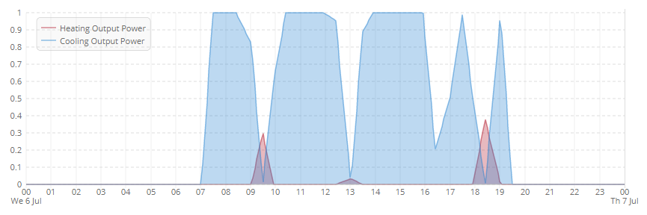
Further Office Comfort Improvement and Energy Savings
There are two main issues with the office fan coil unit (FCU) operation affecting comfort and energy consumption:
‘hunting’, due to too small a FCU deadband setting, and
local difference in thermostat control settings (as set by occupants).
These issues are modelled by by setting an overlapping control band on heating and cooling for the FCU. The
typical ‘hunting’ behavior
design engineers’ strategy is to re-set the thermostat setting and increase the deadband by 0.5°C to 1°C.
After being implemented in the Tas model, the results showed an energy saving of £150,000 and a significant improvement in occupant comfort.
This aspect of the project has been important in prompting the development of more advanced FCU modelling to account for the effects of poor deadband control and setpoint variations.

Slide 15
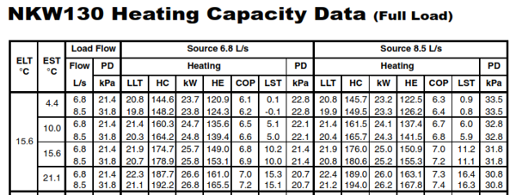
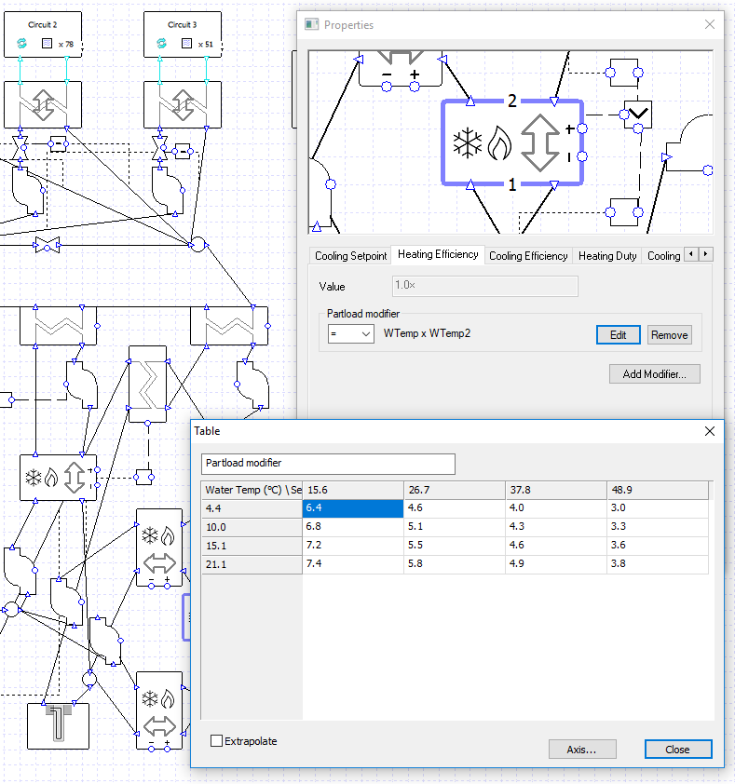
Additional Performance Improvements
Ground loop optimization
Selecting an optimum control strategy for controlling ground loop temperature is non-trivial, due primarily to the variation in heat pump performance.
Tas GenOpt can be used to perform a parametric study optimizing setpoint and size of control band. The table below gives an indication of the best approach.
Starting with a base case of 16°C setpoint and a band of 27°C, the following table shows the percentage energy reduction (or increase) for each alternative.
Office humidity during occupied hours with supply air control
 |  | Setpoint (°C)
 |  | 10 | 13 | 16 | 19 | 22
Band (°C) | 27 |  |  | 0.00%
 | 10 |  | 3.14% | -0.85% | 0.87%
 | 0 | 41.55% | 49.82% | 47.10% | 42.82% | 45.63%
Office humidity during occupied hours with return air control

Slide 16
Conclusion
Case Study: One New Change project
This project demonstrated the benefit of post-occupancy performance modelling. The One New Change project was able to improve system performance and occupant comfort, leading to significant operational cost savings and potential gains in occupant productivity and well being.
Additional use cases for similar studies include proforma analyses for potential projects, in order to calculate projected rates of return on improvements or new construction projects. One New Change, for example, would have yielded a 20% ROI solely from existing systems optimization.
As demonstrated, Tas’ dynamic simulation engine is well suited for performing such studies due to its innovative capabilities in creating unique plant room and airside systems and the accuracy of its simulations. Tas offers integrated data and systems inspection, quick, easy-to-use data visualization tools, and transparent, easy access to data for use in other applications.

