Slide 1
Equipment Efficiency Analysis
Chelmsford, UK

Slide 2

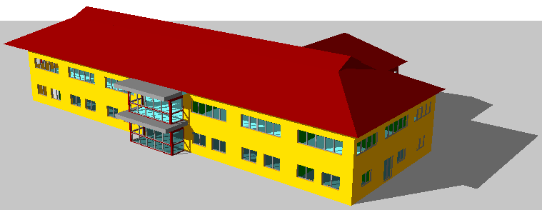
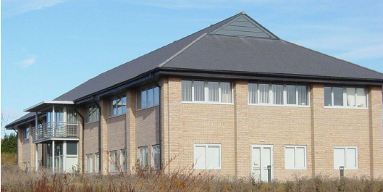
Green BIM & Sustainable Design
Validation & Prediction
UK Chelmsford Office Validation Study
Currently using equipment installed in 2006
Performance Comparison with 2011 Equipment
City Multi R2 system vs a fancoil system with heat recovery

Slide 3
Green BIM & Sustainable Design
Existing Building
Purpose built office
5 City Multi R2 Outdoor units and 25 indoor units
2 Lossnay heat recovery units providing fresh air
Monitored consumption data for an annual period

Slide 4
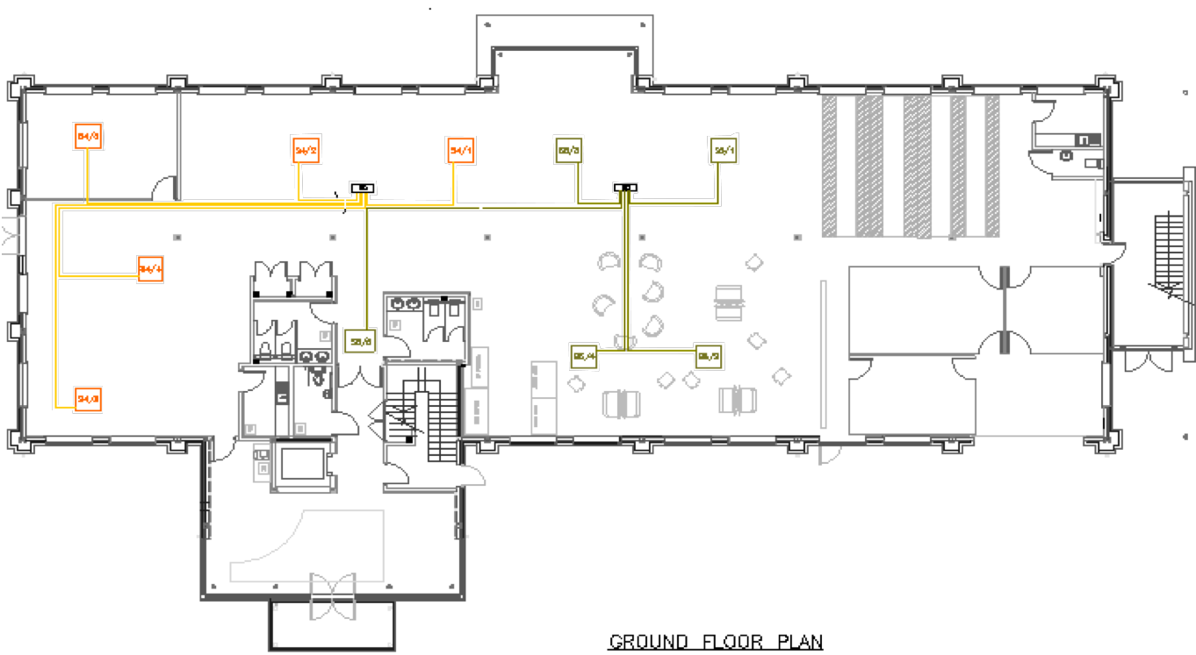
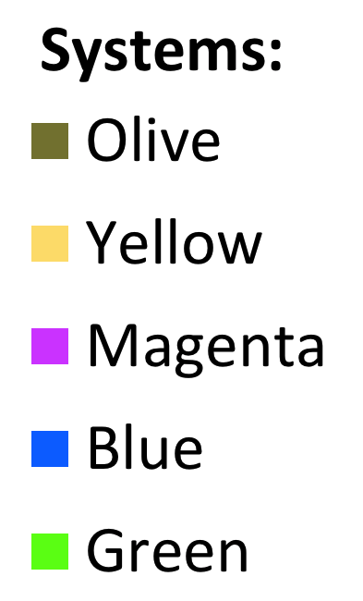
System Layout
Ground Floor
Systems: Olive and Yellow
Mitsubishi Lossnay Fresh Air Heat Recovery Unit

Slide 5
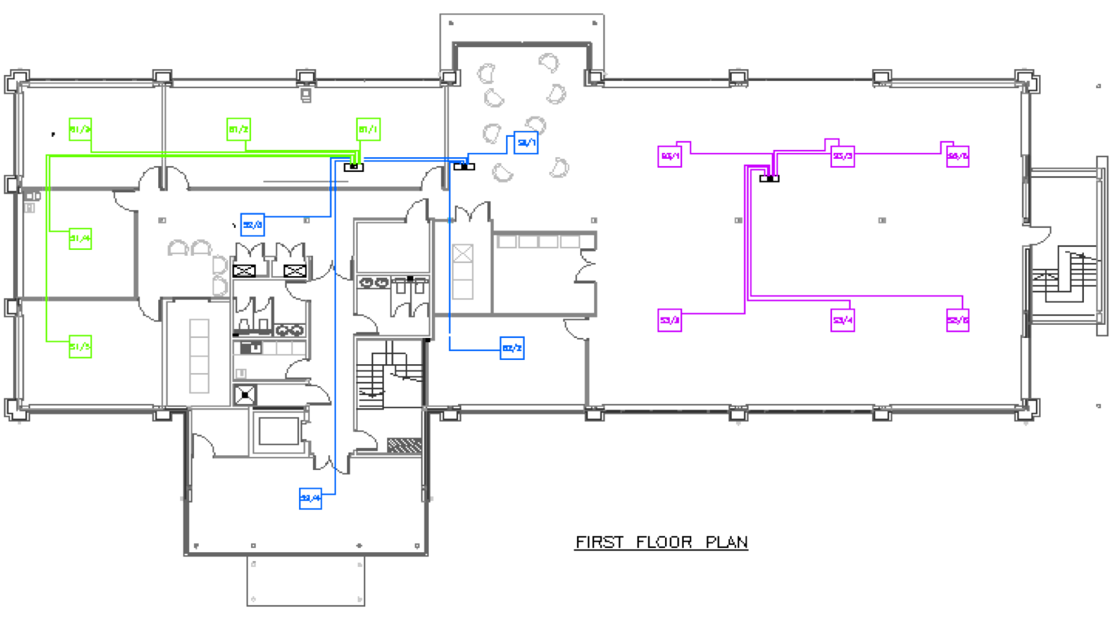
System Layout
First Floor
Systems: Magenta, Blue, Green
Mitsubishi Lossnay Fresh Air Heat Recovery Unit

Slide 6
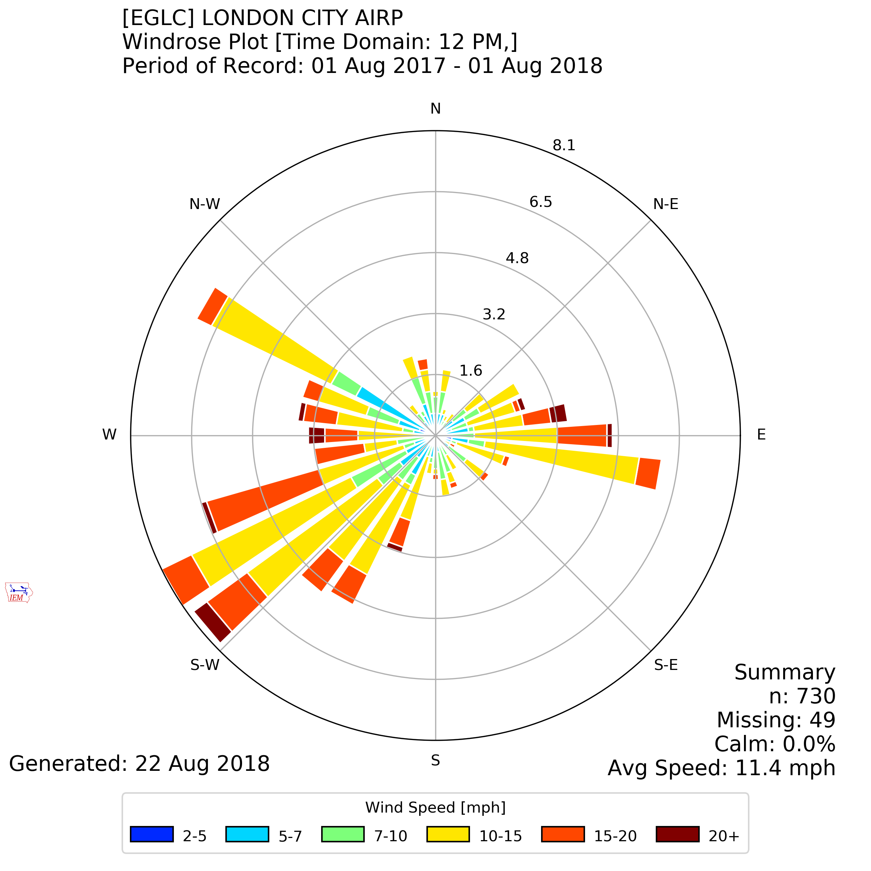
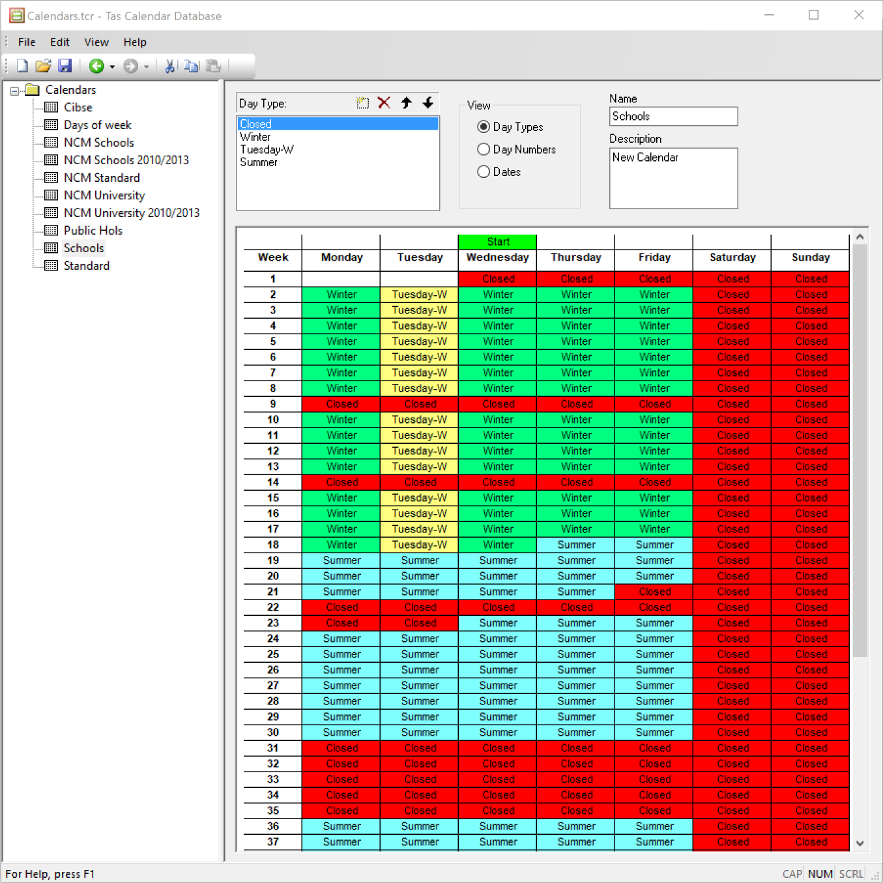
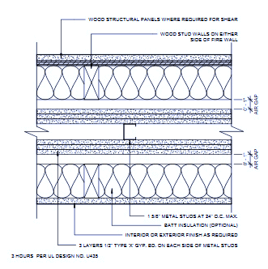
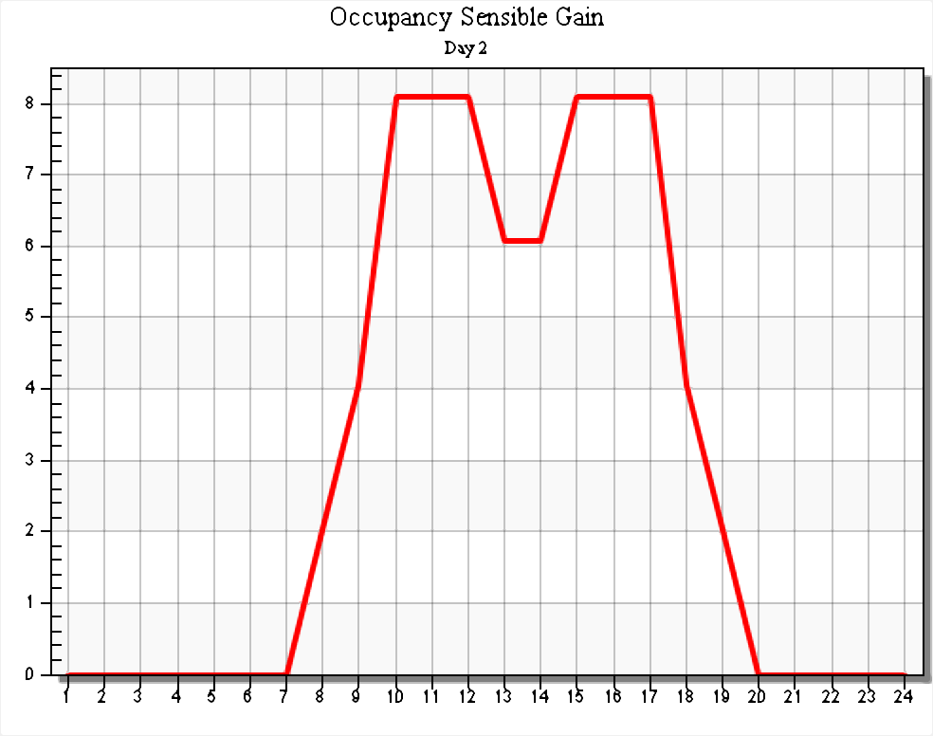
Building Simulation Inputs
Weather Data (London)
Calendar of occupation
Internal Conditions
  Infiltration
  Occupancy Gain
  Equipment Gain
  Fresh Air Requirement
Construction details

Slide 7
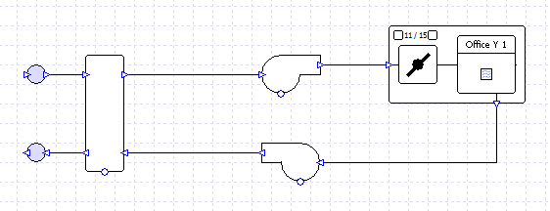
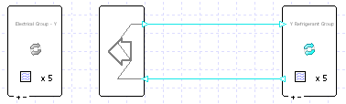
HVAC Simulation Inputs
Air Side Schematic
Plant Side Schematic

Slide 8
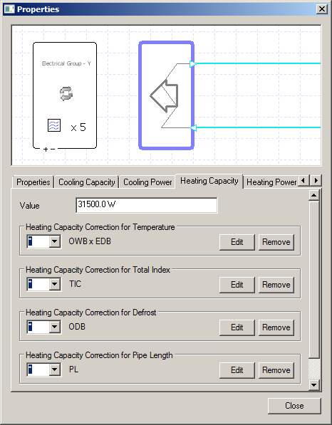
Manufacturer Data Import
Dedicated import function brings manufacturer data into Tas
Tas matches sized systems components to manufacturer-specific equipment
Exchanges system component data with manufacturer-level detail for accurate simulation

Slide 9
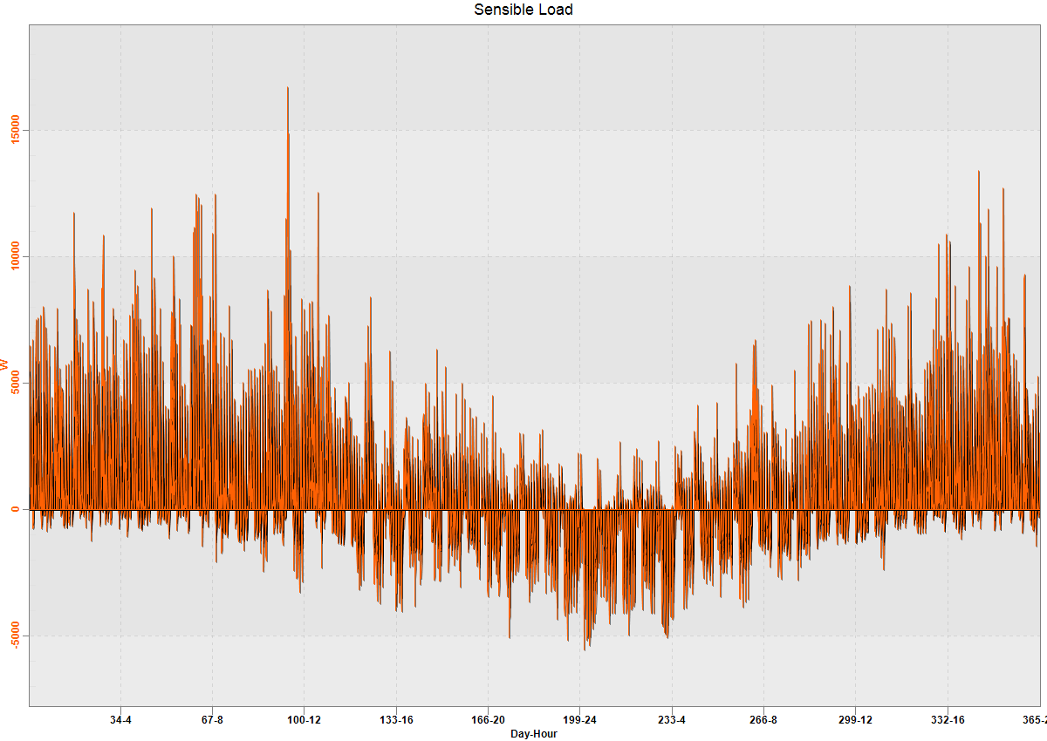
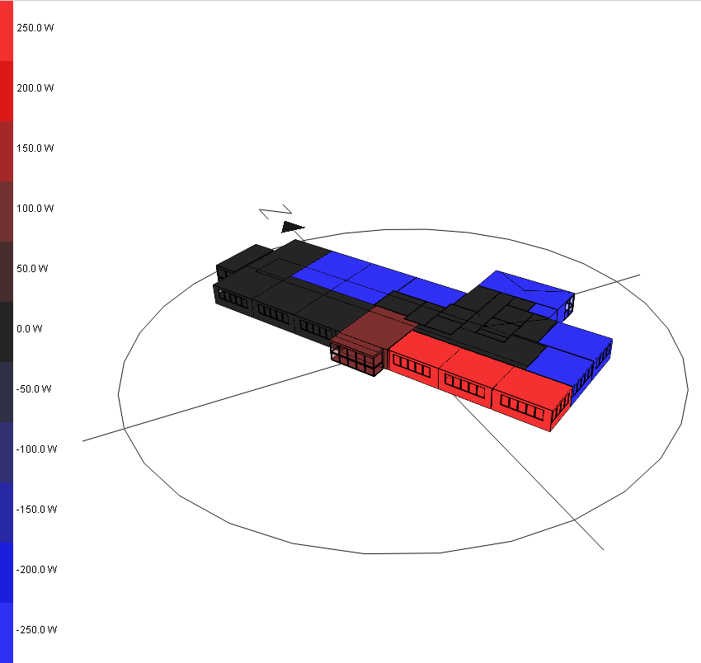
Building Simulation Results
Hourly Building Demand
3D Results Visualisation
First Floor – Hourly Sensible Load Results
First Floor - Sensible Load - Day 50, Hour 12

Slide 10
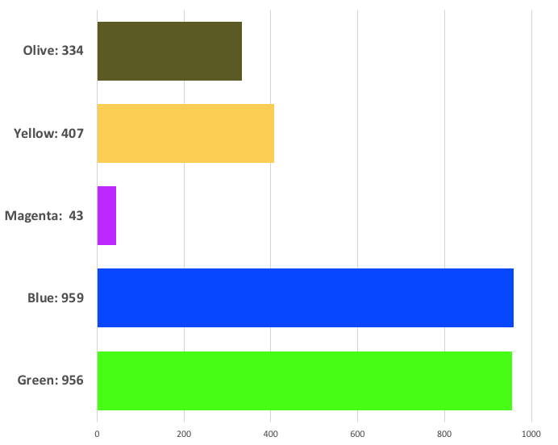
Mitsubishi Lossnay Heat Recovery:
Usage Hours

Slide 11
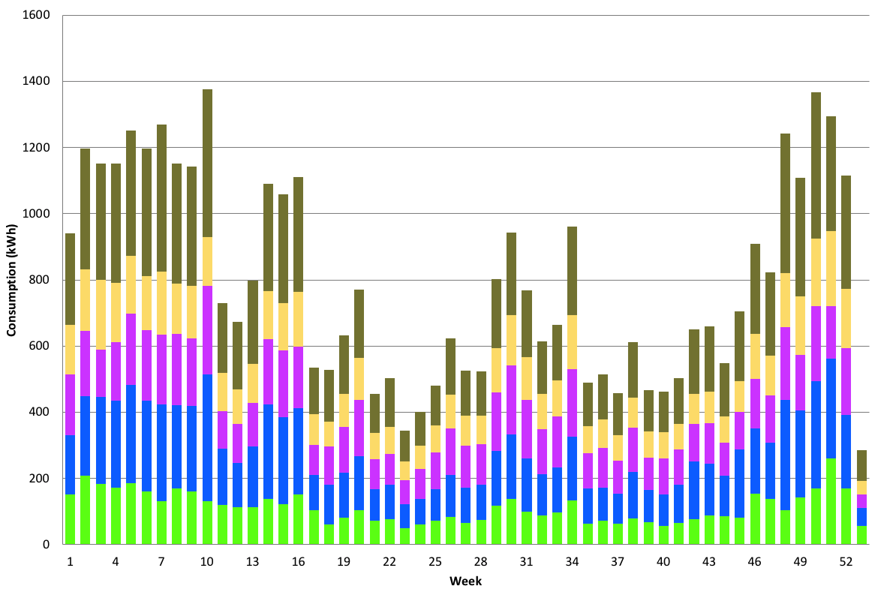
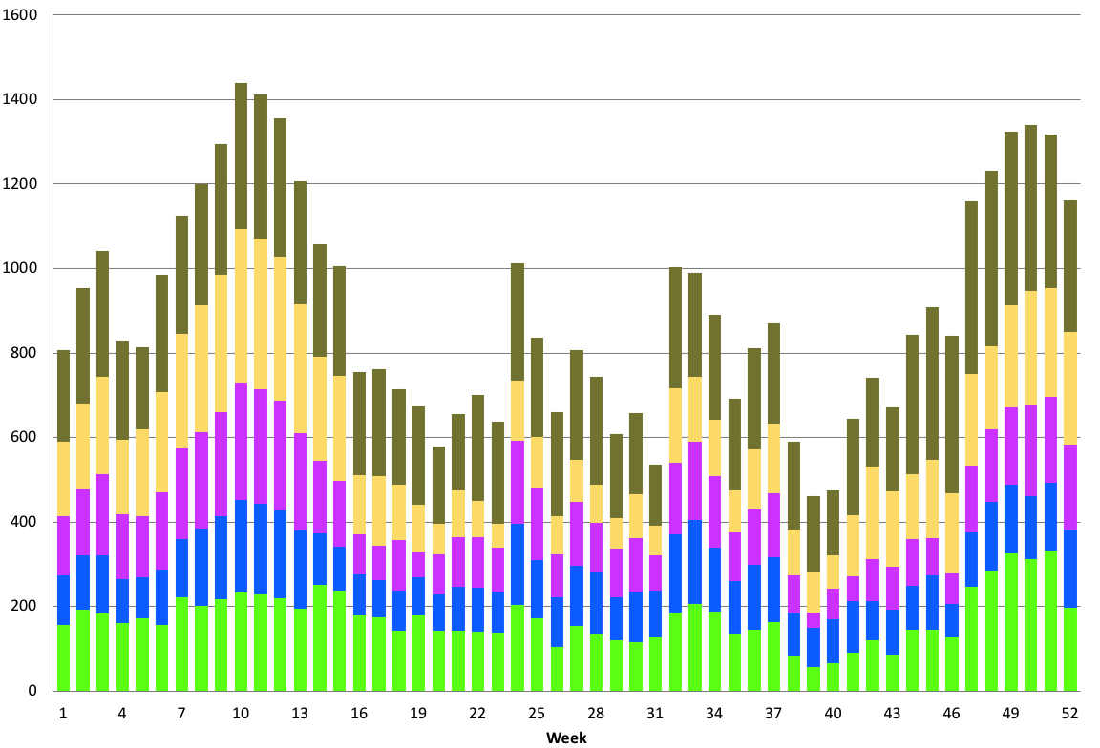
HVAC System Consumption Comparison:
2006 Equipment
Simulated Consumption (installed equipment)
Measured Consumption

Slide 12
Summary & Conclusion
Summary:
The 2011 equipment shows a 34.6% improvement on simulation of the installed 2006 equipment.
 | Annual Consumption (kWh) | Annual Cost (£) | Improvement (%)
Installed Equipment: Measured (2006) | 46,821 | 3,277 | -
Installed Equipment: Simulated (2006) | 42,494 | 2,982 | -
Replacement Equipment: Simulated (2011) | 27,810 | 1,947 | 34.6%
Conclusion:
Detailed simulation of building and plant leads to simulation consumption figures indicative of those seen in the real world application.
‘Good enough’ qualitative agreement between the predicted & measured data to make sound future predictions

