Slide 1
Integrated Daylight Simulation

Slide 2
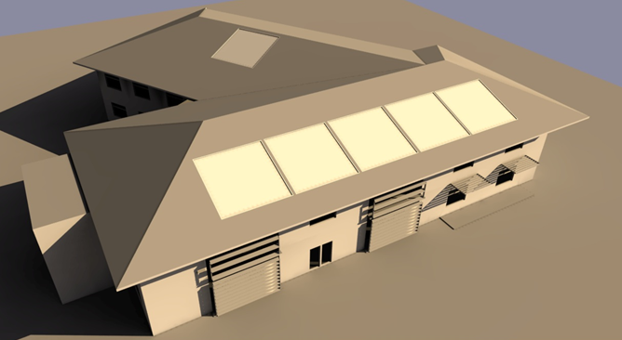
Daylight Render
Tas daylight is based on adaptive radiosity
CIE 171,2006 compliant

Slide 3
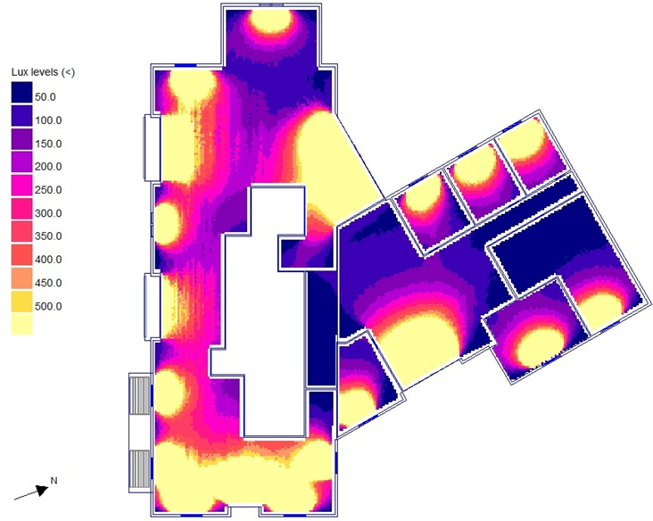
Fast multi-zone daylight simulations
Multi-core processing

Slide 4
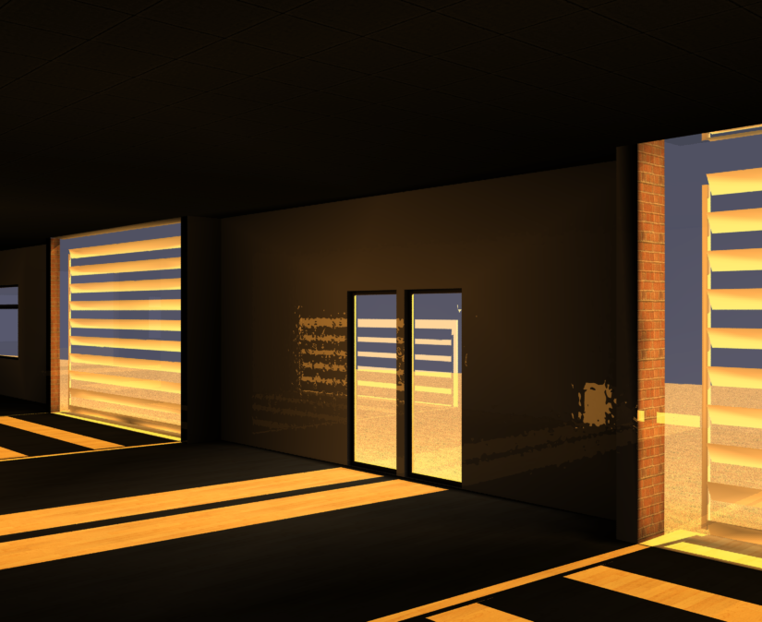
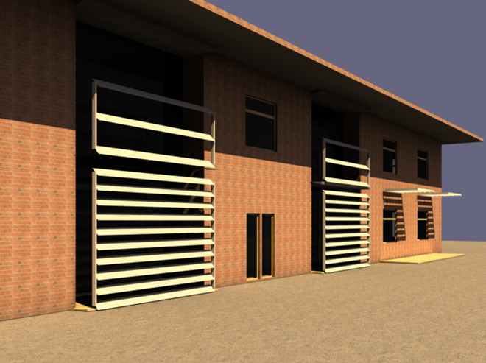
Inside & outside specular reflection analysis
Uses ray tracing over radiosity results
Direct & diffuse daylight simulation and solar shading

Slide 5
Tas Climate Based Daylight Modelling
Climate based daylight modelling originated in the lighting simulation community. Hourly diffuse and direct solar radiation climate data is used to produce daylight coefficients for patches of sky. Irradiance data is converted to illuminance using a luminous efficacy model. The daylight contribution to the space is then calculated hourly through the year for each sky patch.
EDSL’s Tas software has originated in the thermal simulation community. Our Tas software calculates the diffuse and direct solar distribution in spaces hourly through the year. We have developed a daylighting simulation engine, which is fully integrated with our thermal simulation engine. We are, therefore, able to calibrate the daylight contribution from the solar contribution in a space using luminous efficacy. Put simply, we convert the hourly solar income into hourly daylight income.
The following slides illustrate the functionality of the combined thermal and daylight simulation model on a classroom.

Slide 6
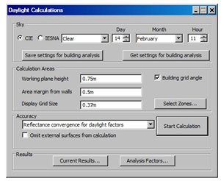
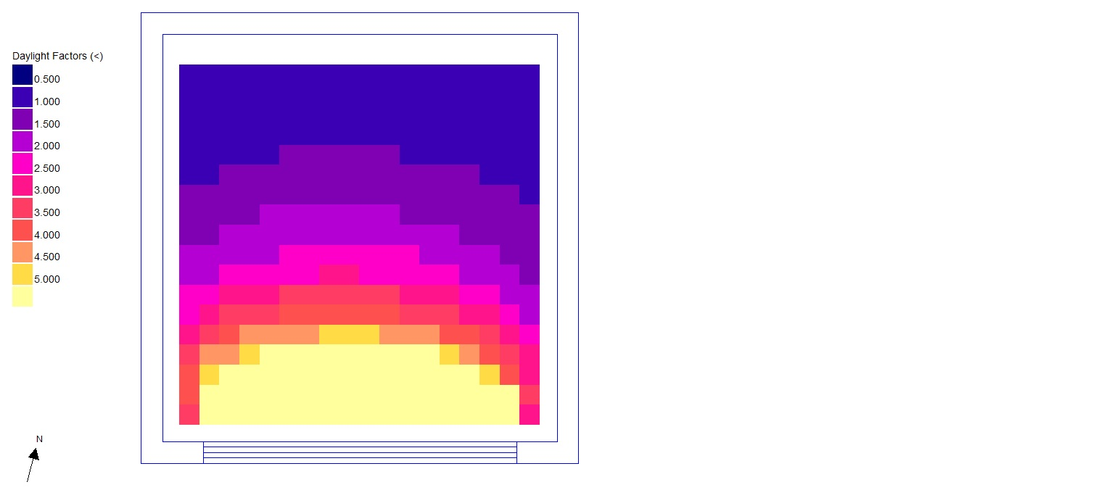
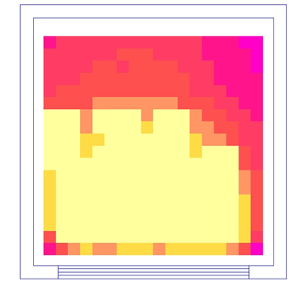
Climate Based Daylight Modeling
Calibrate sampled beam & diffuse daylight analysis against equivalent solar gains from thermal simulations.
Calculate daylight levels from hourly solar gain over a year to produce UDI, DA, daylight distribution

Slide 7
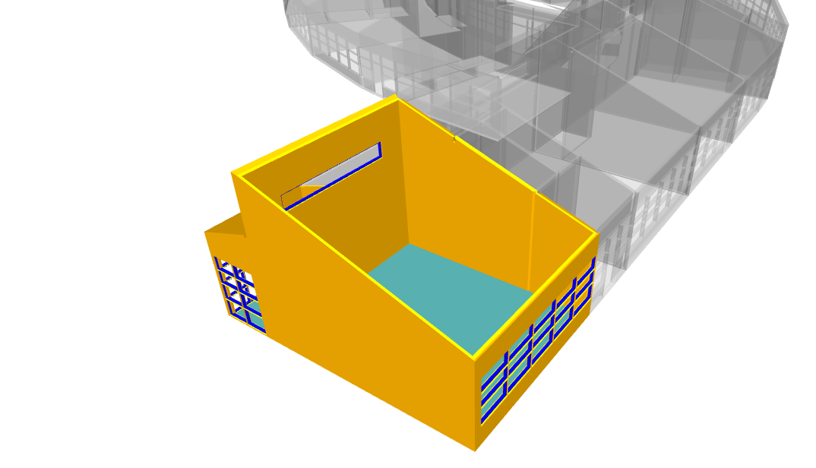
Tas allows specific spaces from a large model to be selected for individual analysis.
A complete range of analysis may be undertaken on the selected space(s) without having to simulate the entire building model.
Here a classroom has been selected to produce CBDM metrics and adaptive comfort analysis.
The roof has been made transparent in the display to show internal layout.

Slide 8
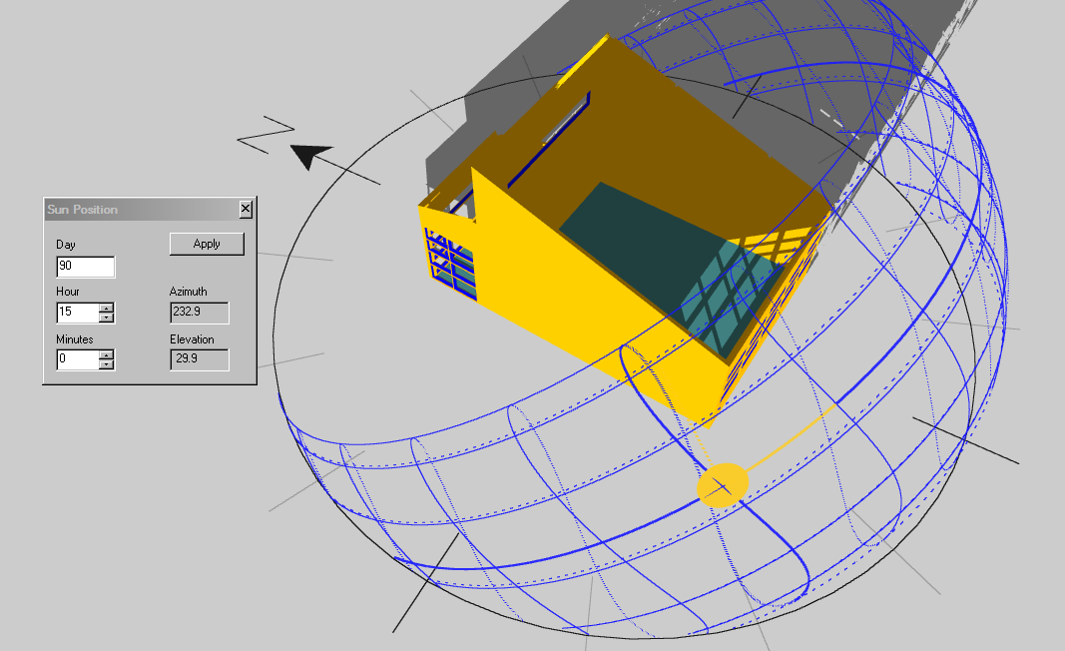
15.00 hours, end of March:
Direct sunlight patches visible through the windows

Slide 9
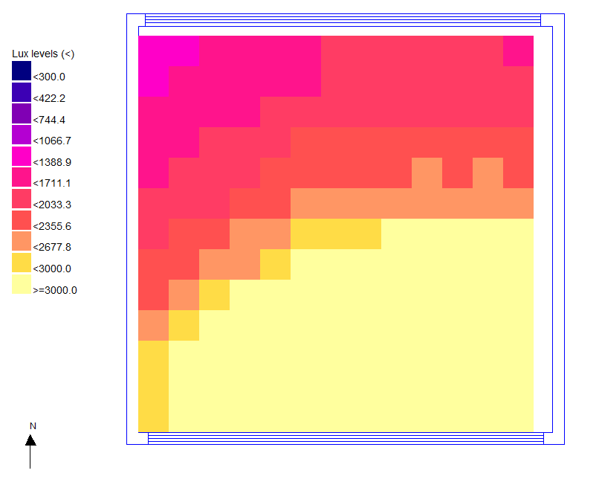
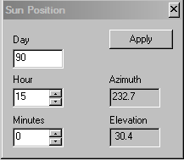
15.00 hours, end of March:
Plan View of Classroom:
Clear sky daylight simulation shows daylight lux level distribution

Slide 10
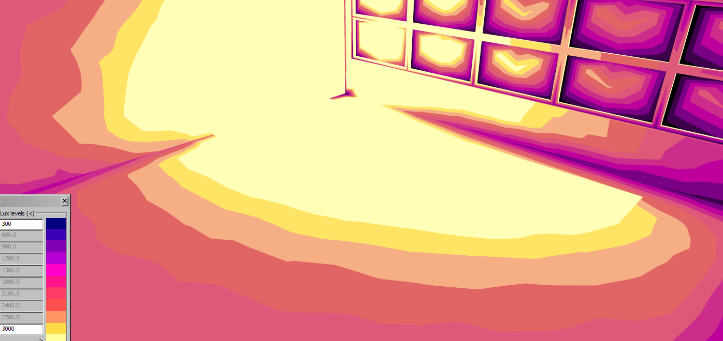
15.00 hours, end of March:
False colour daylight distribution for the same hour

Slide 11
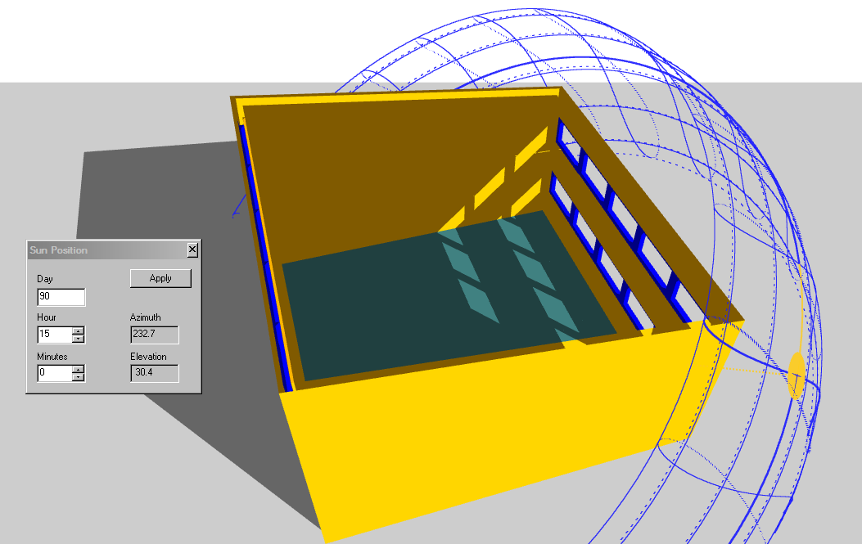
This new configuration of the south wall’s windows has the middle row removed.
The high level windows still throw light to the back of the space.
The view is maintained by the lower row of windows.

Slide 12
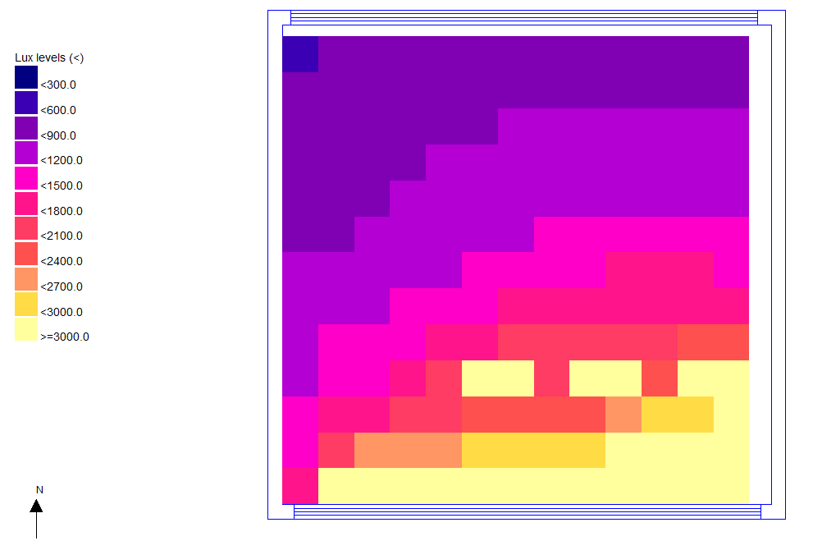
Daylight analysis: 15:00 hours, end of March
A useful amount of daylight is reaching the back of the room via the high level windows.
The amount of direct sunlight next to the windows is reduced.

Slide 13
Original Configuration
Revised Configuration
Daylight analysis: 15:00 hours, end of March
Daylight analysis: 15:00 hours, end of March
Original: 3 rows of windows at south wall
Revised: 2 rows, middle row removed

Slide 14
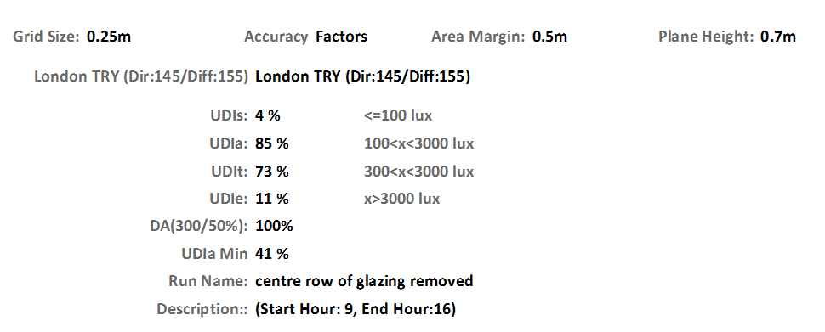
This time the UDIa (UDI - acceptable) is at 85% giving a very good performance.
UDIe (UDI Exceedance) is at an acceptable level.
High level windows have given a good general distribution of daylight
Low level view windows do not produce excessive glare.

Slide 15
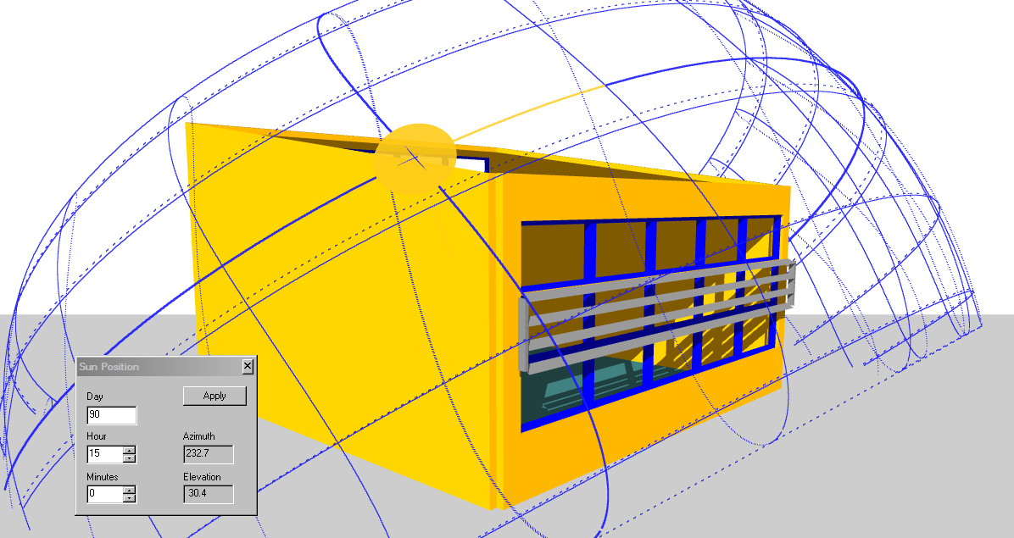
An alternative to removing the middle row of windows would be to provide some solar shading to reduce the direct sunlight
through these windows.
This configuration also had
good CBDM metrics.
Both configurations
worked well on all
orientations.
This façade solution is
but one of
many that
would comply with the
CBDM
criteria

Slide 16
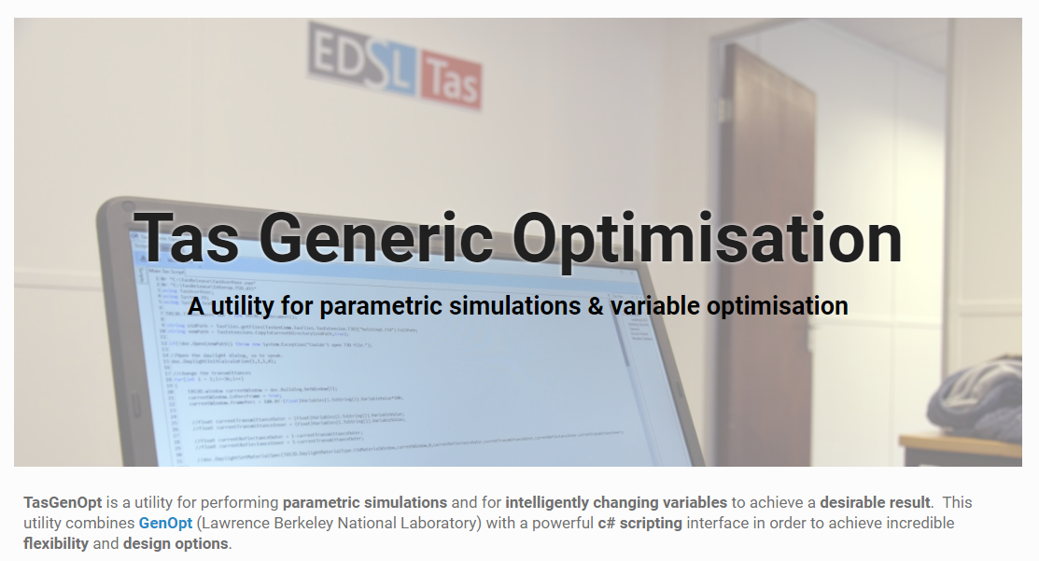

Slide 17
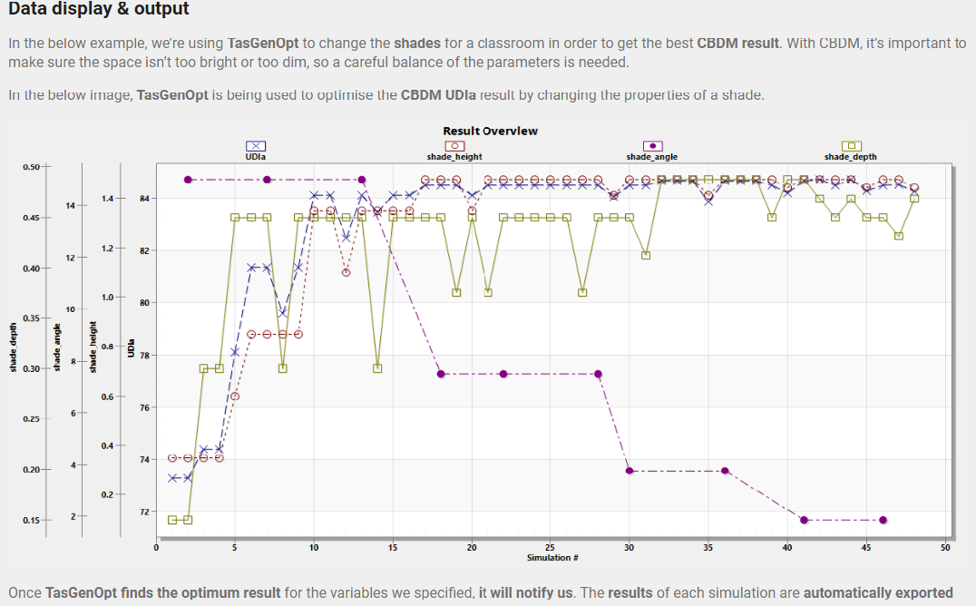
CBDM
Classroom analysis shading configuration optimised for:
shade blade width
vertical spacing
angle

Slide 18
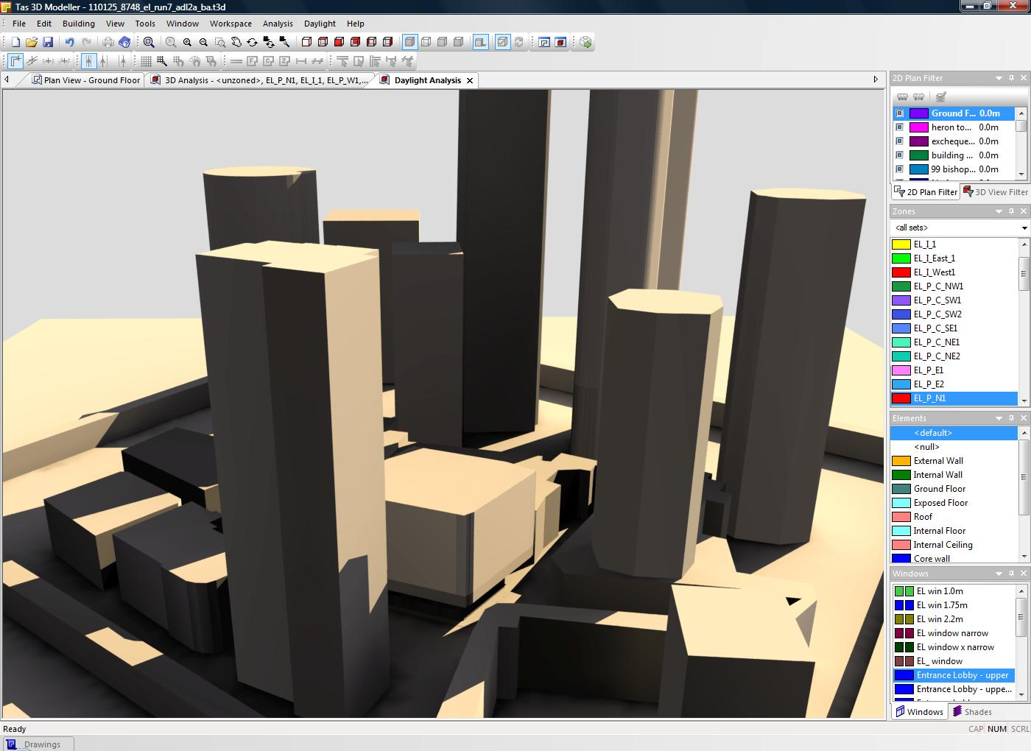
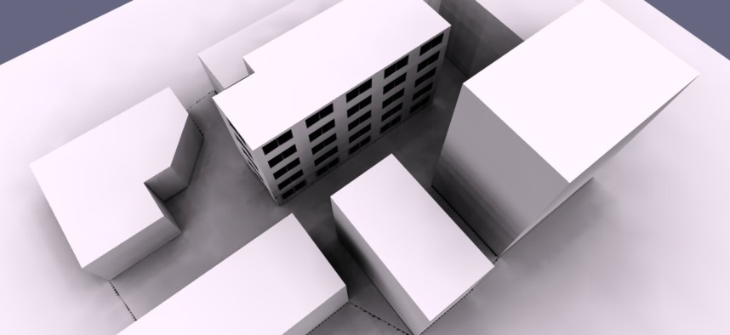
Shadowcast Studies
Context Analysis
Daylight Views

Slide 19
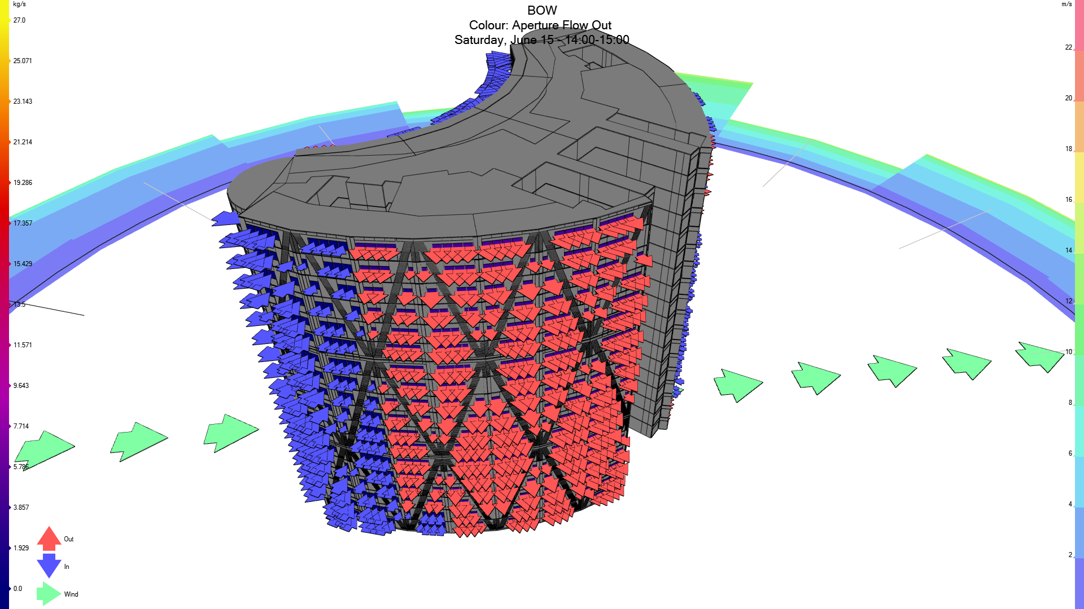
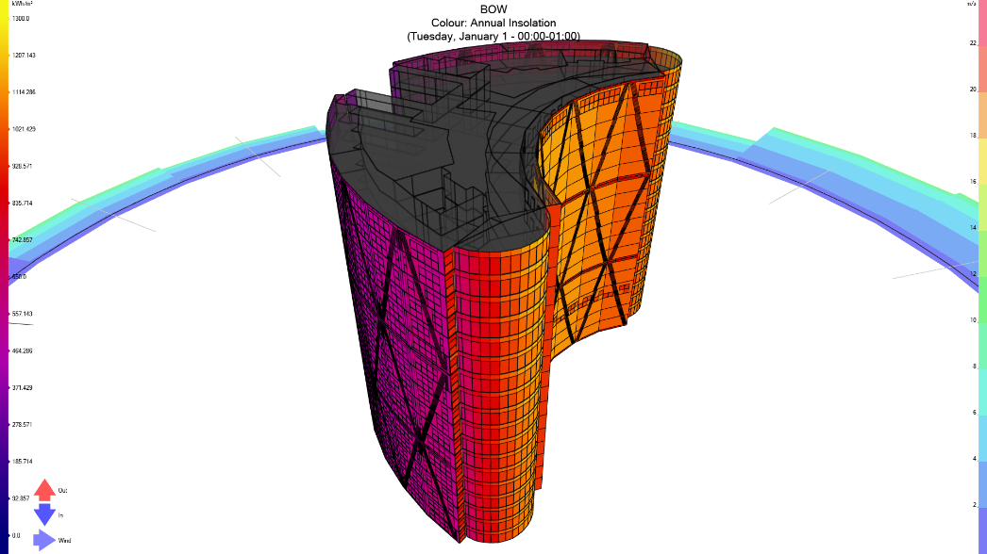
Tas Natural Ventilation Studies
Tas Engineering also offers integrated Natural Ventilation and solar gain (insolation) analysis.
Please visit our website for more details

