Slide 1
Climate Based Daylight Modelling

Slide 2
Tas Climate Based Daylight Modelling
Climate based daylight modelling originated in the lighting simulation community. Hourly diffuse and direct solar radiation climate data is used to produce daylight coefficients for patches of sky. Irradiance data is converted to illuminance using a luminous efficacy model. The daylight contribution to the space is then calculated hourly through the year for each sky patch.
EDSL’s Tas software has originated in the thermal simulation community. Our Tas software calculates the diffuse and direct solar distribution in spaces hourly through the year. We have developed a daylighting simulation engine, which is fully integrated with our thermal simulation engine. We are, therefore, able to calibrate the daylight contribution from the solar contribution in a space using luminous efficacy. Put simply, we convert the hourly solar income into hourly daylight income.
The following slides illustrate the functionality of the combined thermal and daylight simulation model on a classroom.

Slide 3
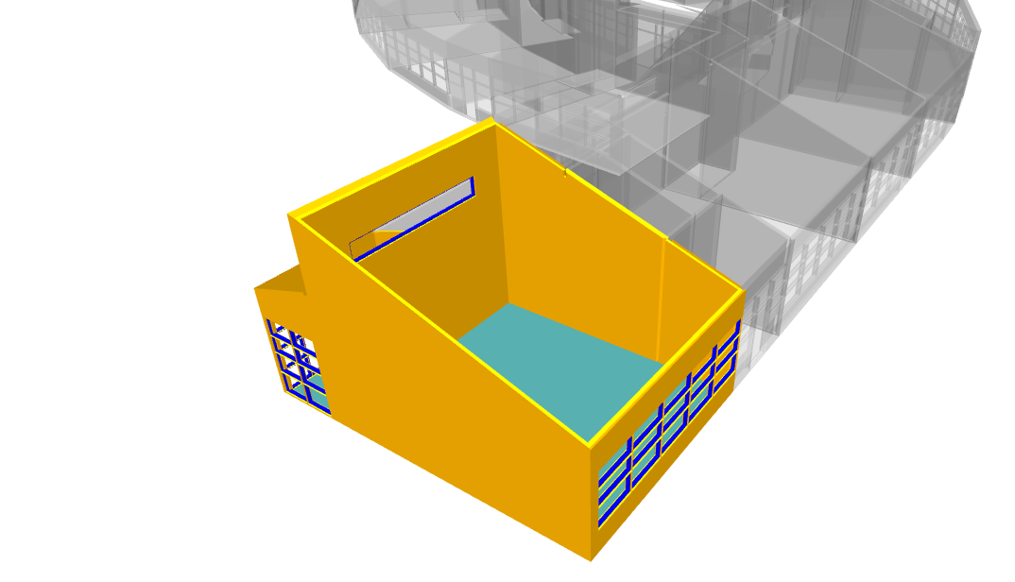
Tas allows specific spaces, from a large model, to be selected for individual analysis. A complete range of analysis may be undertaken on the selected space, or spaces, without having to simulate the whole of the building model.
Here a classroom has been selected to produce CBDM metrics and adaptive comfort analysis.
The roof has been made transparent in the display to show internal layout.

Slide 4
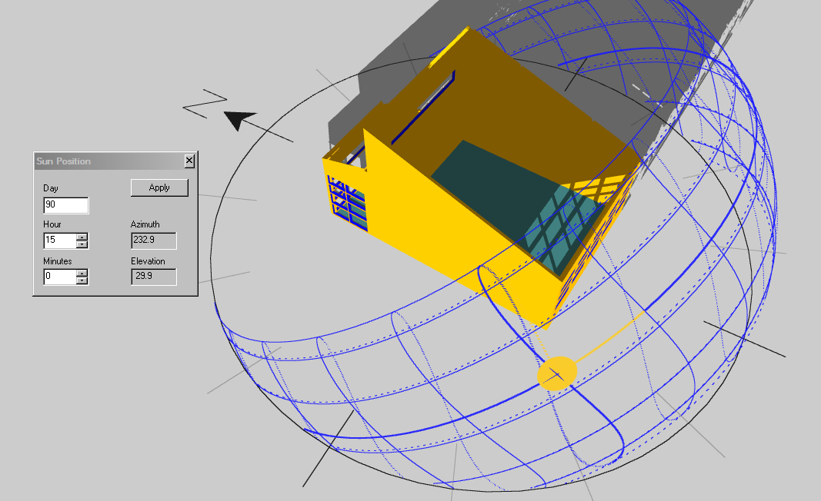
15.00 hours, end of March:
Direct sunlight patches visible through the windows

Slide 5
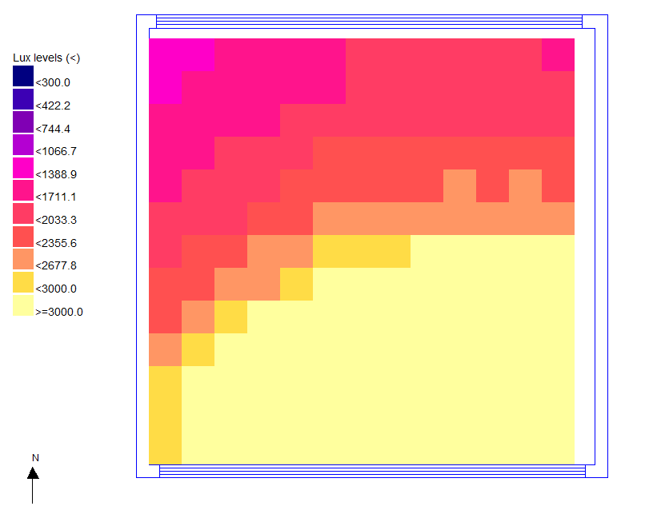
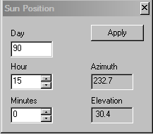
15.00 hours, end of March:
Plan View of Classroom:
Clear sky daylight simulation shows daylight lux level distribution

Slide 6
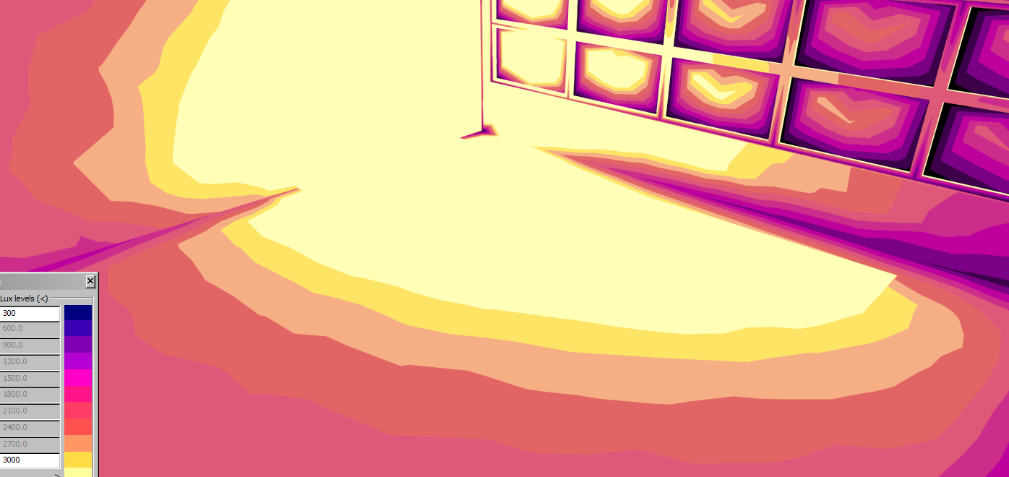
15.00 hours, end of March:
False colour daylight distribution for the same hour

Slide 7
A Summary of the CBDM Metrics
Climate Based Daylight Modelling aims to assess the distribution and intensity of a light within a space.
UDIs – ‘Supplementary’ – Annual occurrences less than ‘UDIa Limit’ lux.
UDIa – ‘Autonomous/ Acceptable’ – Annual occurrence of illuminance between ‘UDIa Limit’ to ‘UDIe Limit’ lux.
UDIt - ‘Target’ – Annual occurrence of illuminances greater than ‘UDIe Limit’ lux.
UDIe – ‘Exceedance/ Excessive’ – Annual occurrence of illuminances greater than ‘UDIe Limit’ lux.
DA – ‘Daylight Autonomy’ – Amount of time a space reaches minimum acceptable illuminance
In the UDIs range, electric lighting is required.
In the UDIa range, electric lighting is not required.
In the UDIe range, spaces may be subject to glare and be too bright for the occupants.

Slide 8
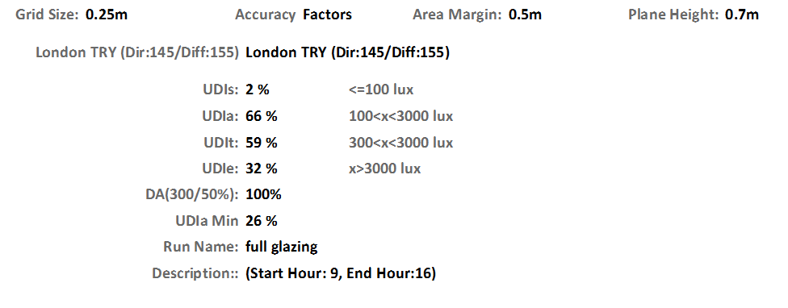
*
CBDM metrics show that the
UDIa at 66% is below the acceptable level.
The UDIe at 32% indicates that there could well be excessive glare for about a third of occupied hours.
*
‘Autonomous/ Acceptable’, ‘Target’, & ‘Exceedance/ Excessive’ lux levels can be varied to match location & conditions. Values can be adjusted in Tas. This example uses 100/ 300/ 3000 lux

Slide 9
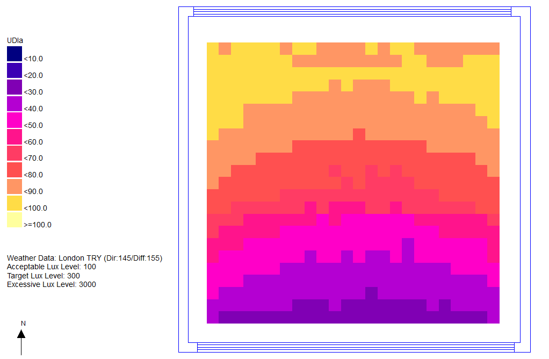
Plan View of Classroom:
The UDIa distribution over the working plane shows poor performance in the front third of the space.

Slide 10
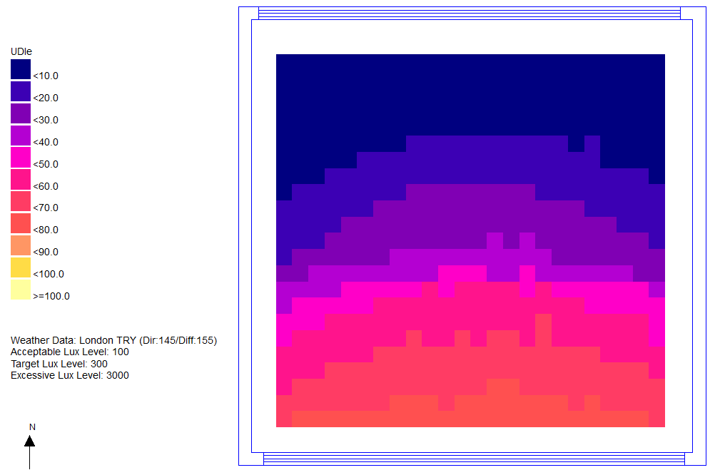
Plan View of Classroom:
The UDIe levels are excessive at the south end of the classroom
The glazing configuration is meant to throw daylight to the back of the classroom, which is achieved, but at the expense of performance closer to the windows.

Slide 11
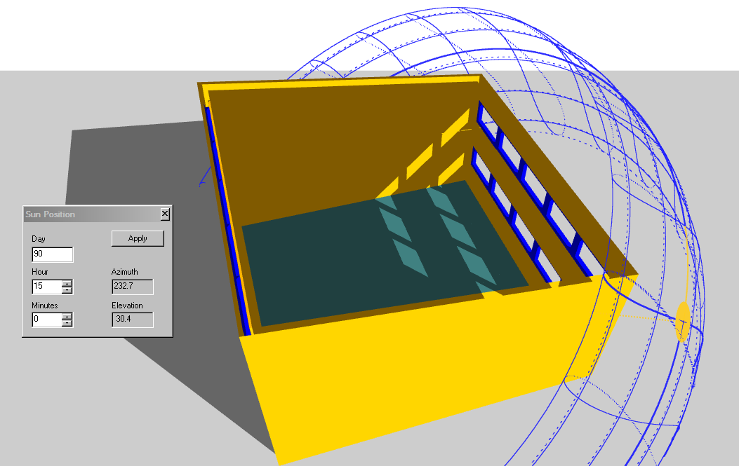
This new configuration of the south wall’s windows has the middle row removed.
The high level windows still throw light to the back of the space.
The view is maintained by the lower row of windows.

Slide 12
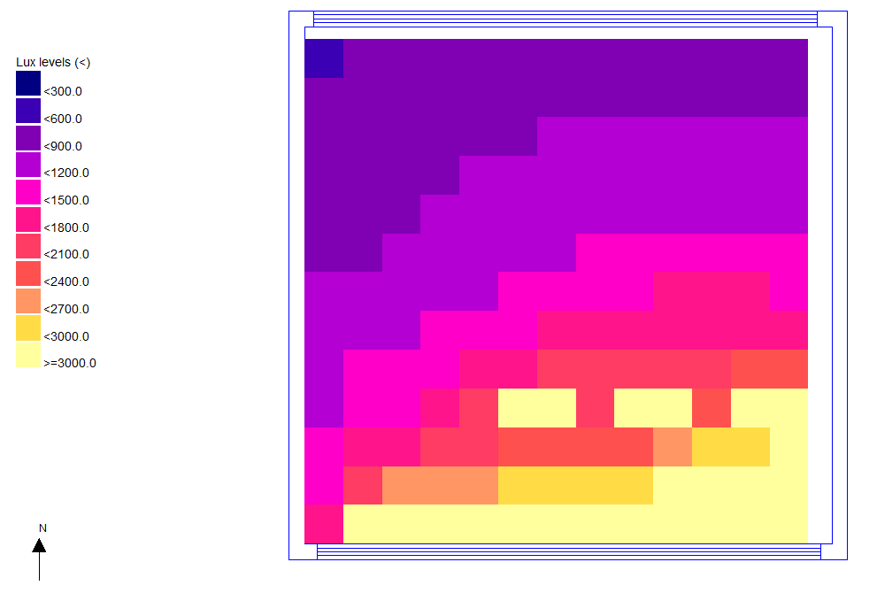
Daylight analysis: 15:00 hours, end of March
A useful amount of daylight is reaching the back of the room via the high level windows.
The amount of direct sunlight next to the windows is reduced.

Slide 13
Original Configuration
Revised Configuration
Daylight analysis: 15:00 hours, end of March
Daylight analysis: 15:00 hours, end of March
Original: 3 rows of windows at south wall
Revised: 2 rows, middle row removed

Slide 14
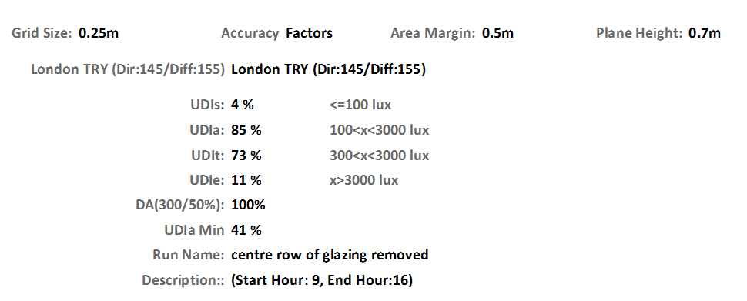
This time the UDIa is at 85% giving a very good performance.
UDIe is at an acceptable level.
High level windows have given a good general distribution of daylight and the low level view windows do not produce excessive glare.

Slide 15
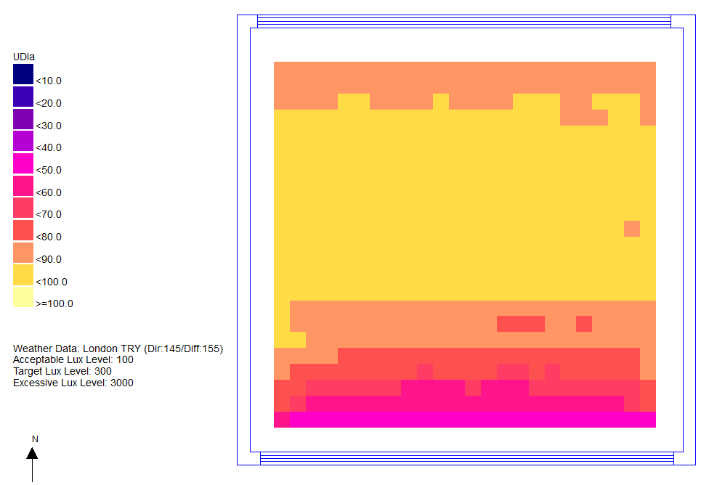
Daylight analysis: 15:00 hours, end of March
The UDIa distribution is quite flat, which is ideal.

Slide 16
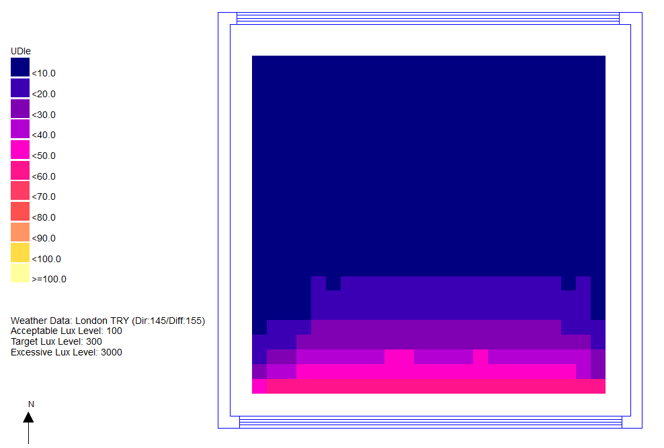
UDIe is confined to close to the view windows.

Slide 17
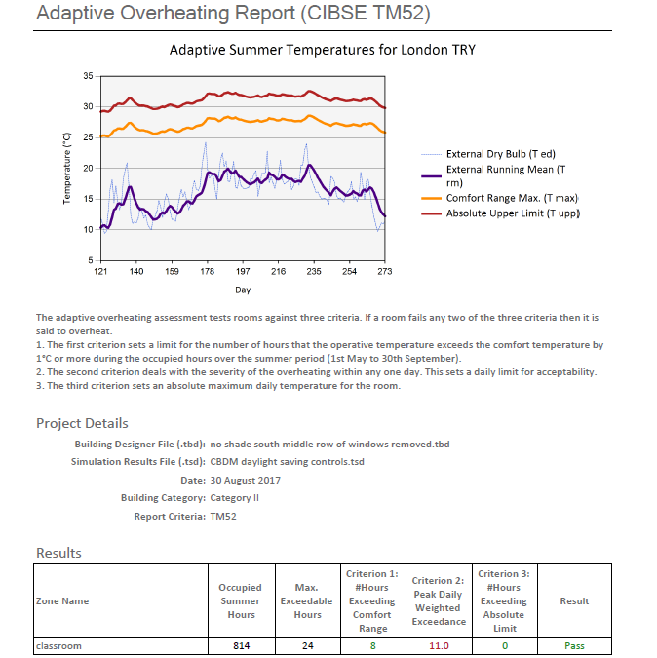
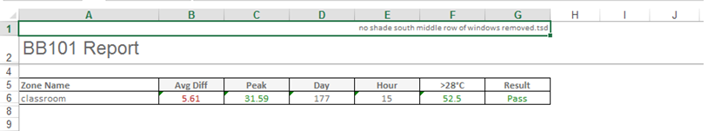
The high level windows at the front and back of the room are good for daylight distribution, but are also very useful for natural ventilation combined with some limited view window opening.
The reduction in lighting gains has also helped to achieve a pass on BB101 with the London Test Reference Year (TRY) weather set, and on TM52 when using the same weather set.
Performance metrics can be output to Excel or pdf as shown.

Slide 18
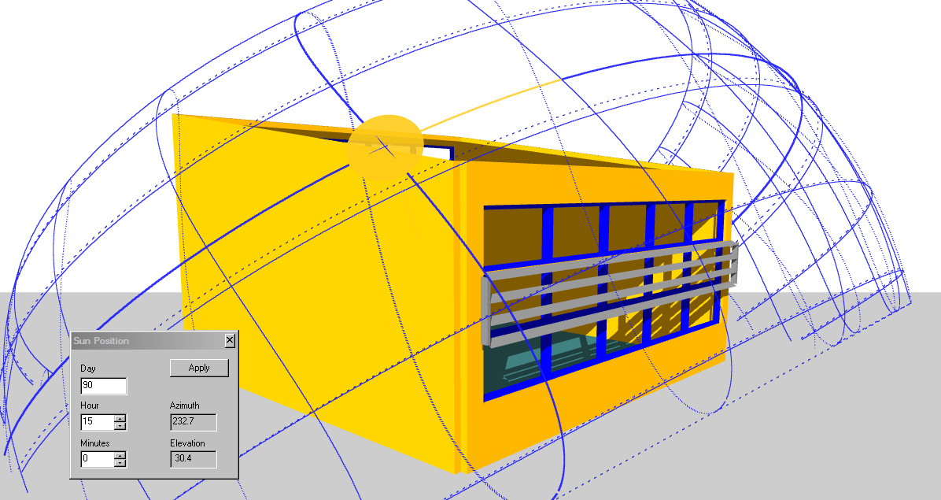
An alternative to removing the middle row of windows would be to provide some solar shading to reduce the direct sunlight
through these windows.
This configuration also had
good CBDM metrics.
Both configurations
worked well on all
orientations.
This façade solution is
but one of
many that
would comply with the
CBDM
criteria

Slide 19
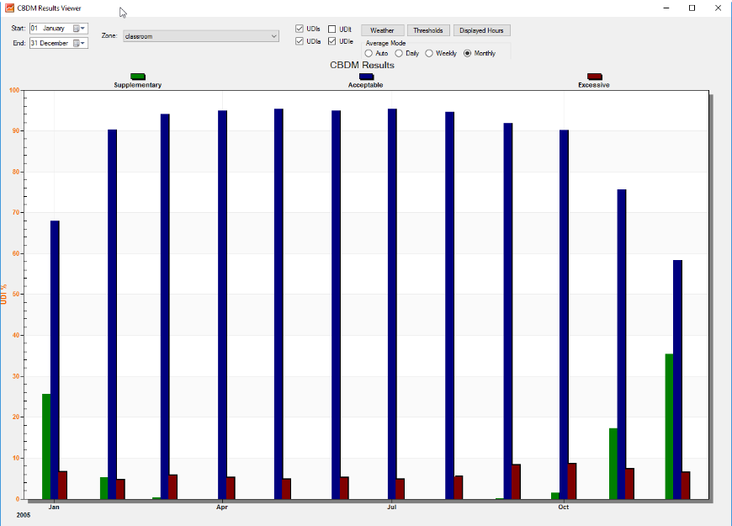
To provide an insight into the single number metrics for the whole year, they are available on a monthly, weekly, and hourly basis.
UDIs (Supplementary)
UDIa (Acceptable)
UDIe (Excessive)
The secret to a successful solution is to have the ‘Excessive’ level consistently low over the year.

Slide 20
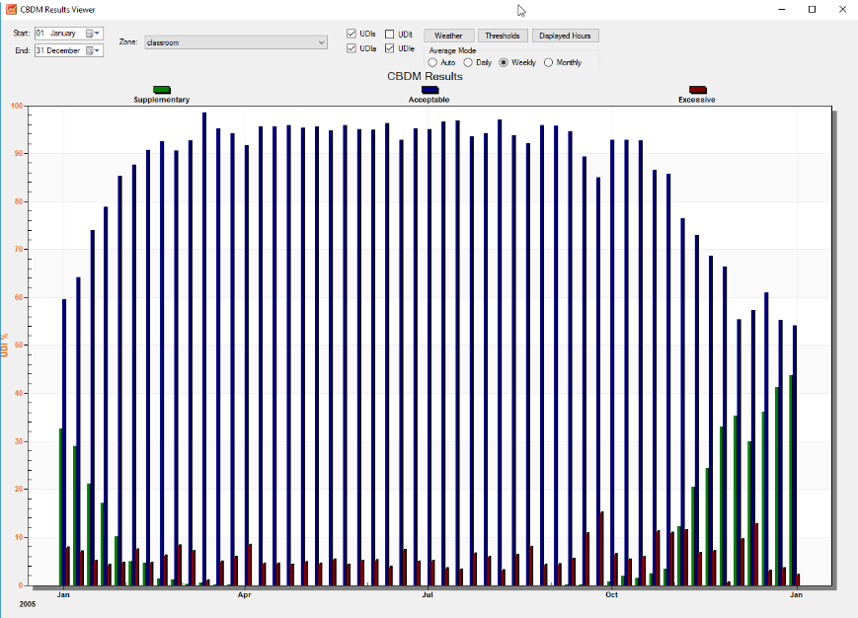
Weekly distribution
UDIs (Supplementary)
UDIa (Acceptable)
UDIe (Excessive)

Slide 21
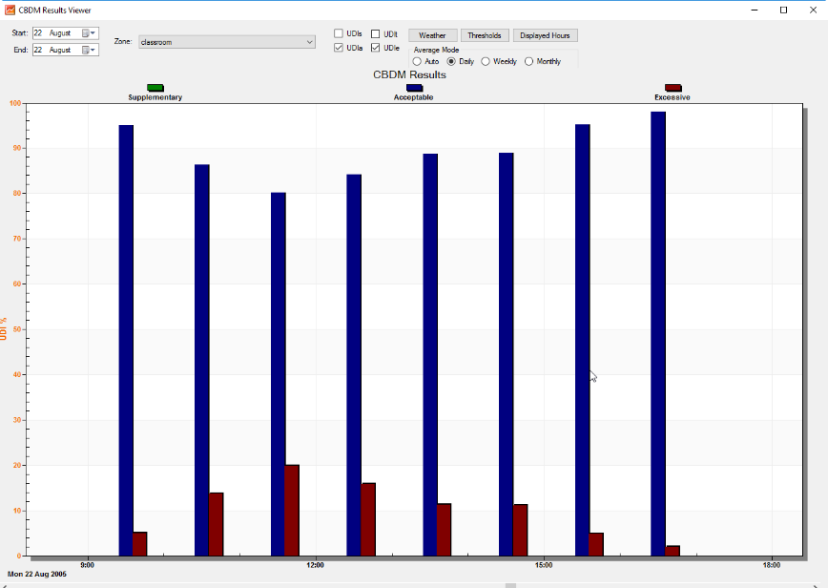
Hourly distribution
UDIs (Supplementary)
UDIa (Acceptable)
UDIe (Excessive)

Slide 22
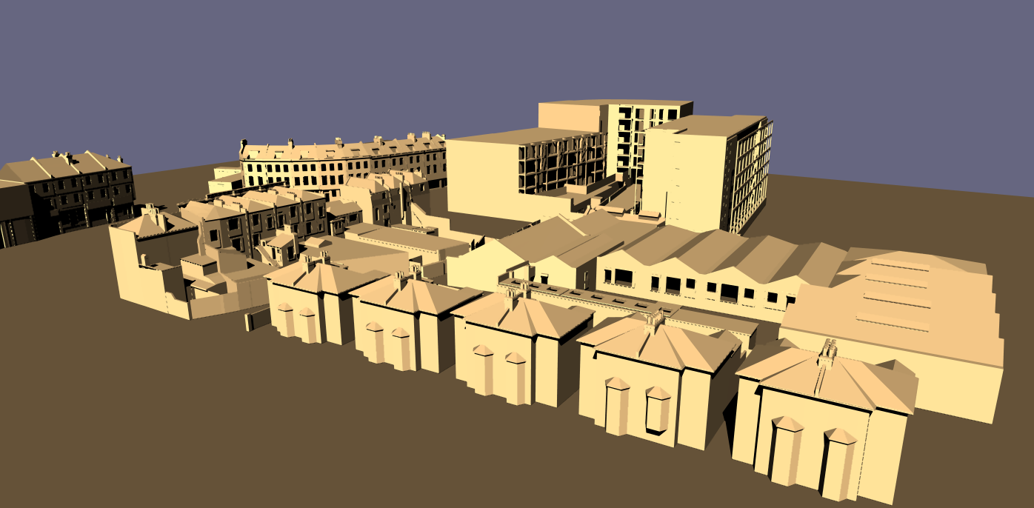
The Tas daylight engine is able to provide analysis for LEED and BREEAM daylight credits. It is also able to undertake all Right to Light calculations, supported by the ability to import 3D DWG cityscape models.

