Slide 1
Tas Climate Based Daylight Modelling
Climate based daylight modelling originated in the lighting simulation community. Hourly diffuse and direct solar radiation climate data is used to produce daylight coefficients for patches of sky. Irradiance data is converted to illuminance using a luminous efficacy model. The daylight contribution to the space is then calculated hourly through the year for each sky patch.
EDSL’s Tas software has originated in the thermal simulation community. Our Tas software calculates the diffuse and direct solar distribution in spaces hourly through the year. We have developed a daylighting simulation engine, which is fully integrated with our thermal simulation engine. We are, therefore, able to calibrate the daylight contribution from the solar contribution in a space using luminous efficacy. Put simply, we convert the hourly solar income into hourly daylight income.
The following slides illustrate the functionality of the combined thermal and daylight simulation model on a classroom.

Slide 2
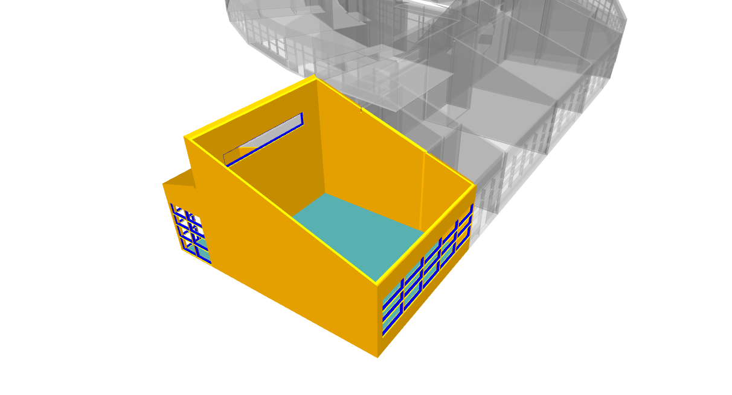
Tas allows specific spaces, from a large model, to be selected for individual analysis. A complete range of analysis may be undertaken on the selected space, or spaces, without having to simulate the whole of the building model.
Here a classroom has been selected to produce CBDM metrics and adaptive comfort analysis.
The roof has been made transparent in the display to show internal layout.

Slide 3
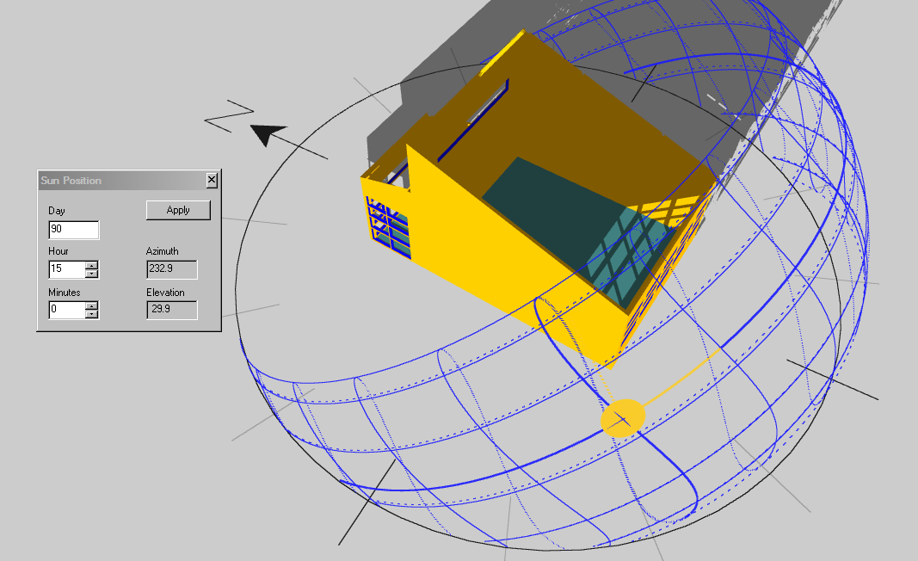
This image shows the direct sunlight patches for 15.00 hours around the end of March

Slide 4
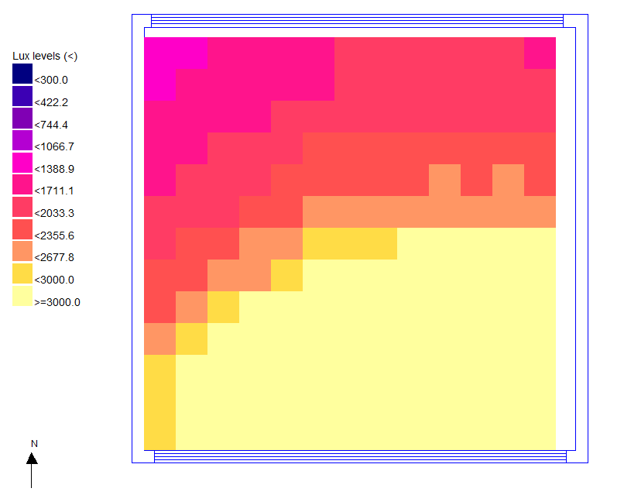
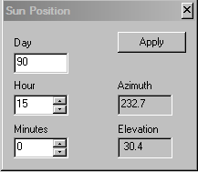
For the same hour a clear sky daylight simulation shows the daylight lux level distribution

Slide 5
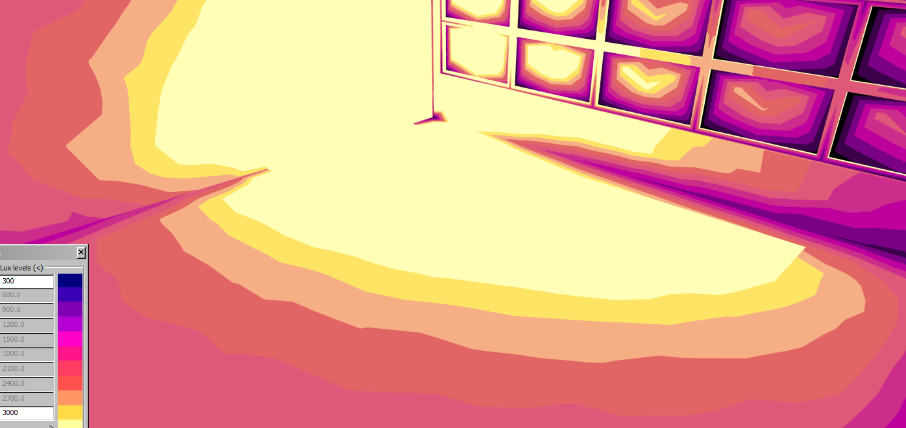
False colour daylight distribution for the same hour

Slide 6
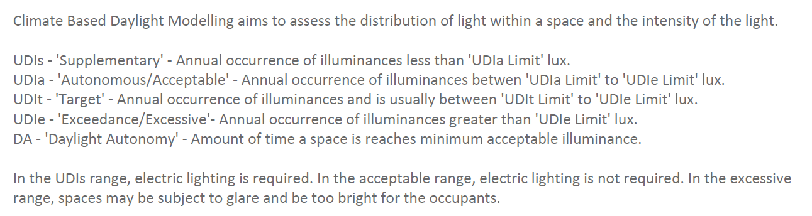
A summary of the CBDM metrics

Slide 7
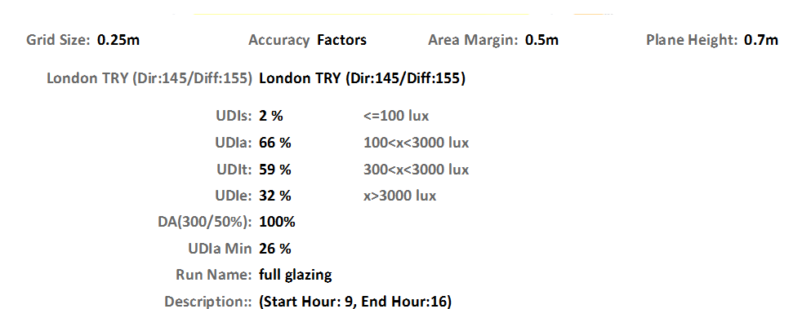
CBDM metrics show that the
UDIa at 66% is below the acceptable level.
The UDIe at 32% indicates that there could well be excessive glare for about a third of occupied hours.

Slide 8
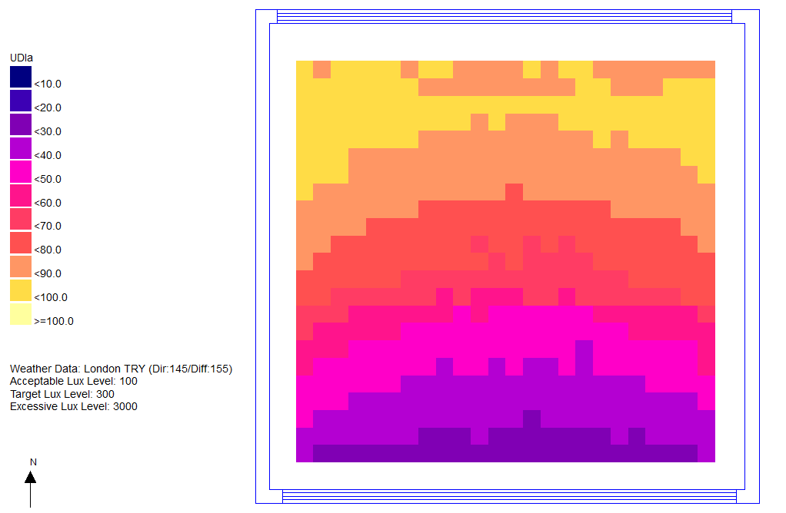
The UDIa distribution over the working plane shows poor performance in the front third of the space.

Slide 9
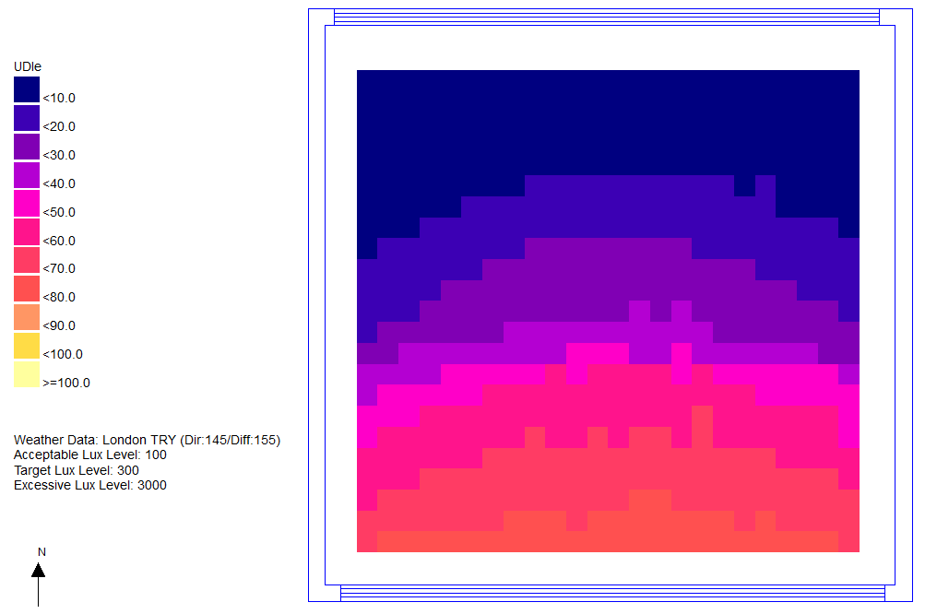
Again, the UDIe levels are excessive at the glazed end of the classroom
The glazing configuration is meant to throw daylight to the back of the classroom, which is achieved, but at the expense of performance closer to the windows.

Slide 10
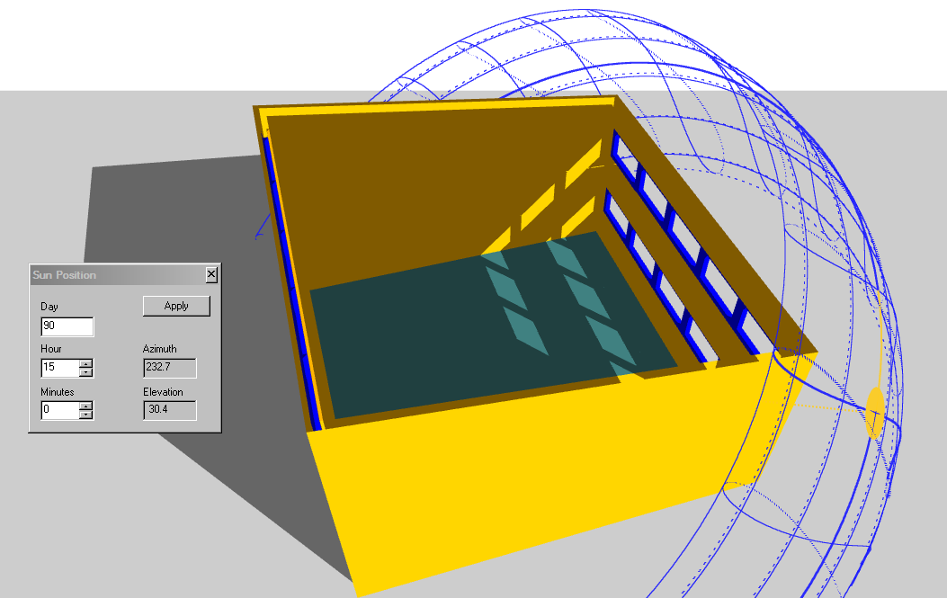
This new configuration of windows has the middle row removed.
The high level windows still throw light to the back of the space and the view is maintained by the lower row of windows.

Slide 11
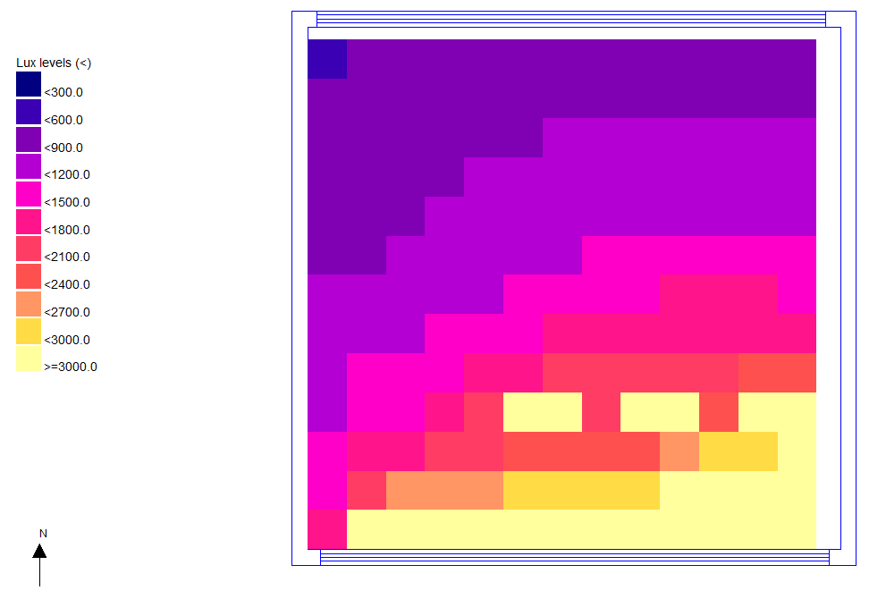
A daylight analysis for 15:00 hours at the end of March shows that a useful amount of daylight is reaching the back of the room via the high level windows. Also the amount of direct sunlight next to the windows is reduced.

Slide 12
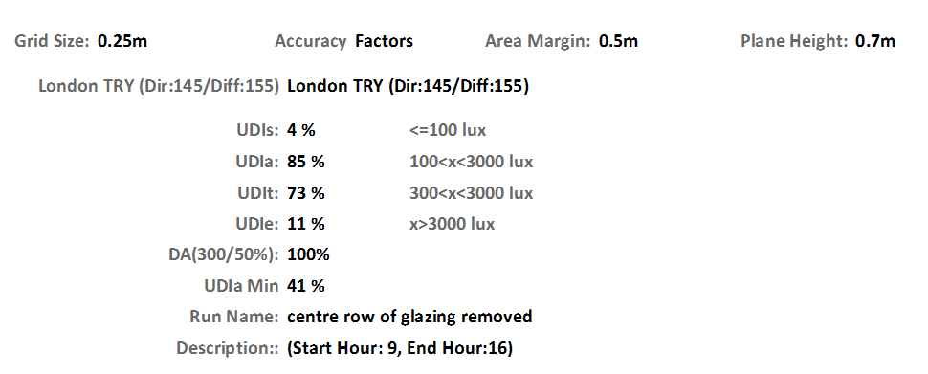
This time the UDIa is at 85% giving a very good performance.
UDIe is at an acceptable level.
High level windows have given a good general distribution of daylight and the low level view windows do not produce excessive glare.

Slide 13
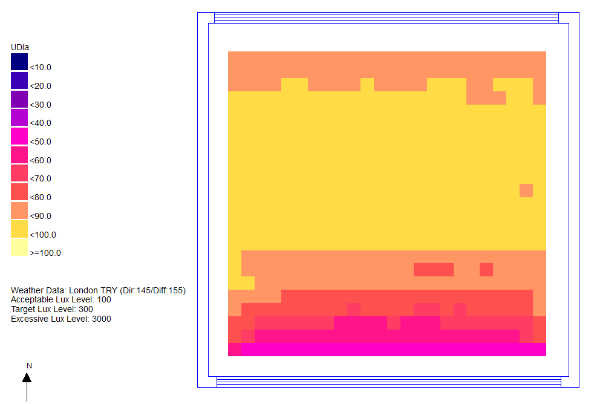
The UDIa distribution is quite flat, which is ideal.

Slide 14
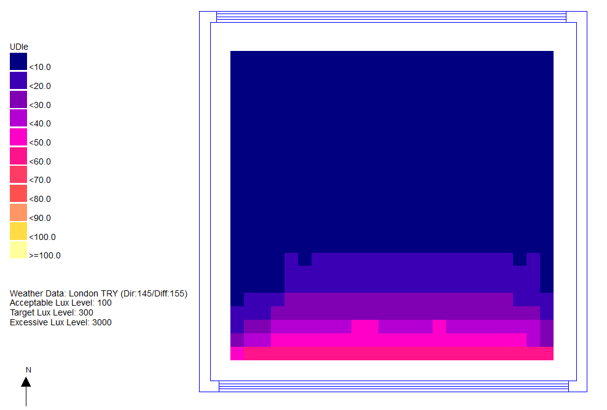
UDIe is confined to close to the view windows.

Slide 15
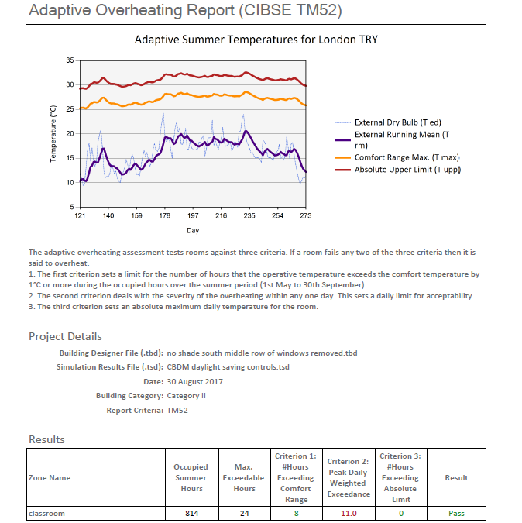
The high level windows at the front and back of the room are good for daylight distribution, but are also very useful for natural ventilation combined with some limited view window opening.
The reduction in lighting gains has also helped to get a TM 52 pass with the London TRY weather set.

Slide 16
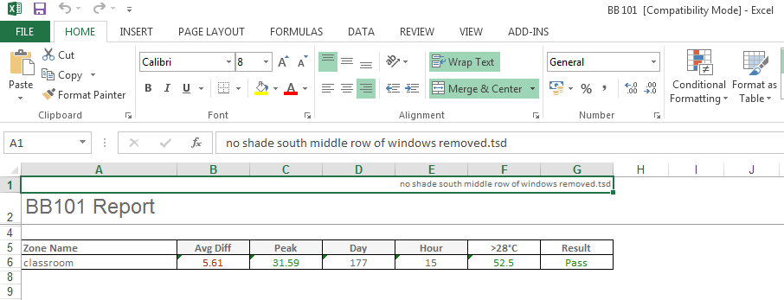
Also a BB 101 pass.
This time performance metrics are exported into Excel

Slide 17
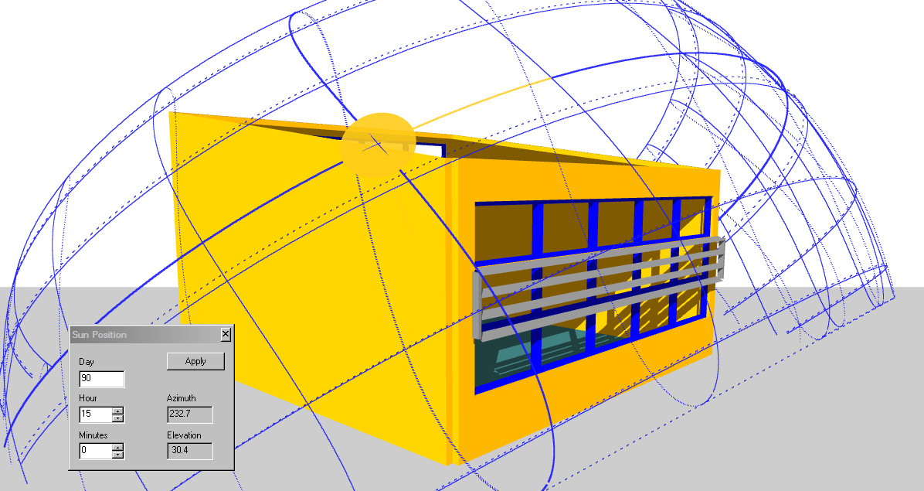
An alternative to removing the middle row of windows would be to provide some solar shading to reduce the direct sunlight through these windows.
This configuration also had good CBDM metrics. Both configurations worked well on all orientations.
This façade solution is but one of many that would comply with the CBDM criteria

Slide 18
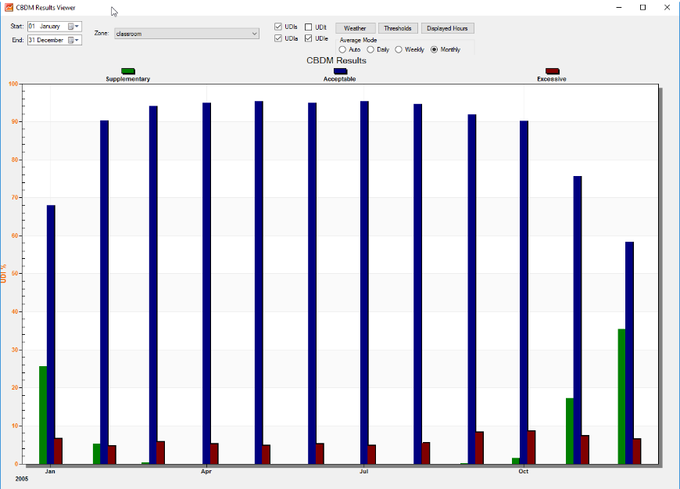
To provide an insight into the single number metrics for the whole year, they are available on a monthly, weekly and hourly basis.
The secret to a successful solution is to have the ‘Excessive’ level consistently low over the year.

Slide 19
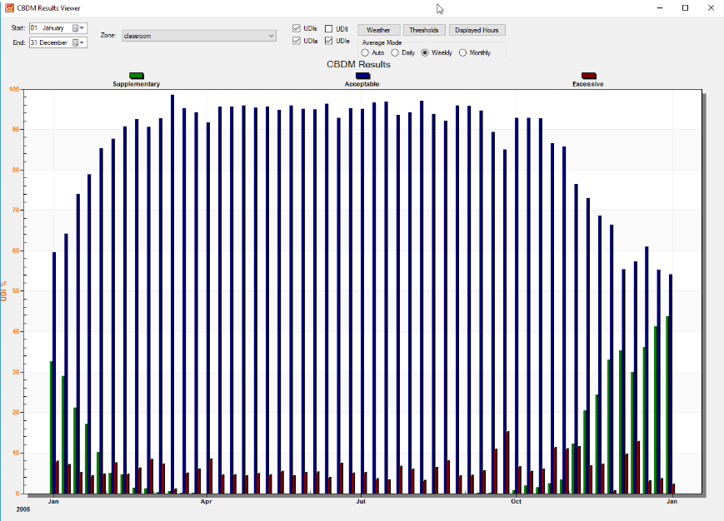
Weekly distribution

Slide 20
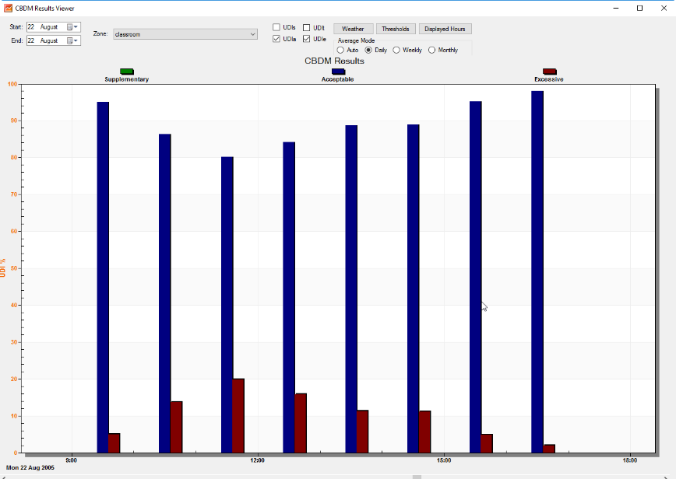
Hourly distribution

Slide 21
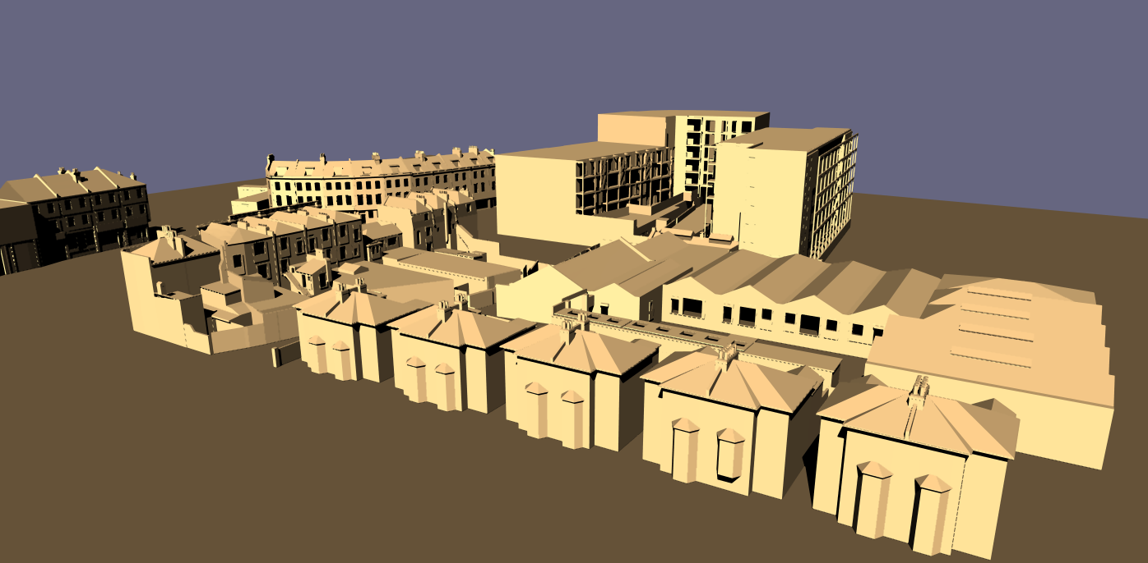
The Tas daylight engine is able to provide analysis for BREEAM and LEED daylight credits. It is also able to undertake all Right to Light calculations, including the import of 3D DWG cityscape models.

